Slide 1
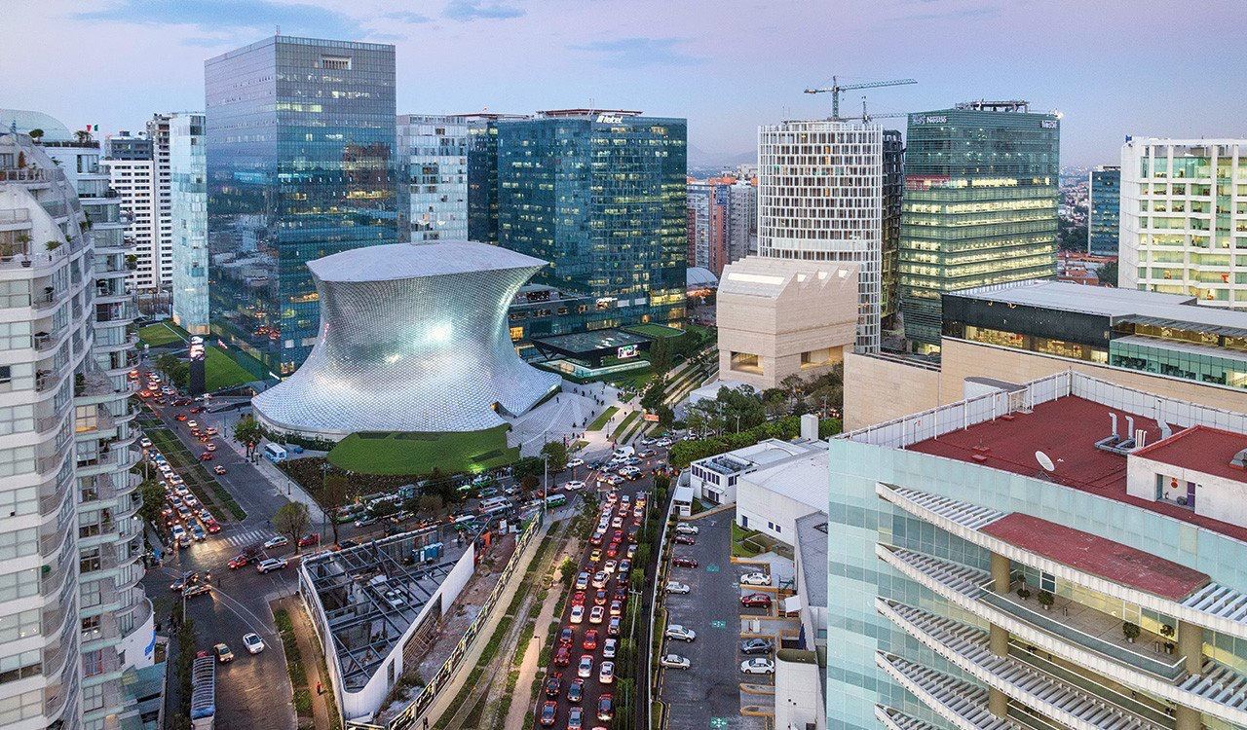



Smart Cities
MEXICO
Tomasz Dominik Kotecki
General Deputy Director for Housing Analysis, Prospective
and Sustainability
@koteckitomasz

Slide 2
As of 2015, there is about 52% of the world population living in cities
Smart City enabler is the estimated 15 percent savings in global carbon emissions that it can deliver by 2020
Cities consume about 70% of the global energy use
By 2050, the United Nations (UN) is expecting that 66% people will be living in cities
US$40 trillion will need to be invested in urban infrastructure over the next 20 years
The market for smart city systems is estimated at over $400 billion by 2020
Every week, there are at least a million new people moving into cities
Polarized economic growth: The 600 largest global cities will contribute 65 percent of global GDP growth from 2010–2025.
Notes:
Misma unidad para comparar % o millones de personas

Slide 3
Smart Cities Definitions

Slide 4


Cities that adopt ‘scalable solutions that take advantage of information and communications technology (ICT) to increase efficiencies, reduce costs, and enhance quality of life’ Cities that take this approach are commonly referred to as Smart Cities, or Smart+Connected Communities (S+CC)
Cities that adopt ‘ ‘Smart’ delivery of services relies on Information and Communication Technology (ICT) as key enabler and that the systems involved can profit from the ability to be highly interconnected through various technologies’.
PRIVATE
Notes:
Portada _Smart cities around the world
PRIVATE SECTOR

Slide 5


A Smart city can be defined as the integration of data and digital technologies into a strategic approach to sustainability, citizen wellbeing and economic development
GOVERNMENT
Smart Hong Kong – Embracing innovation and technology to build a strong economy, enhance quality of living and make Hong Kong a well-known Smart City.
Notes:
GOVERNMENT

Slide 6


Smart Cities initiatives try to improve urban performance by using data, information and information technologies (IT) to provide more efficient services to citizens, to monitor and optimize existing infrastructure, to increase collaboration among different economic actors, and to encourage innovative business models in both the private and public sectors.
— Maria-Lluïsa Marsal-Llacuna
ACADEMY
A city is smart when investments in human and social capital and traditional (transport) and modern (ICT) communication infrastructure fuel sustainable economic growth and a high quality of life, with a wise management of natural resources, through participatory governance
—Andrea Caragliu
Notes:
ACADEMY

Slide 7
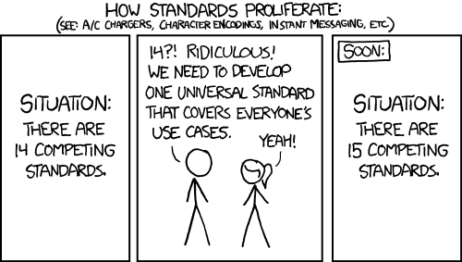

Slide 8

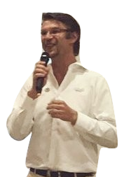
DEFINITION
A Smart City is one that has not forgotten it’s purpose, prosperity through community.
A Smart City is a platform that generates the development and wellbeing of its citizens, a system of systems which facilitates and enables interaction of technology, information, policy, society and decision making, ensuring tangible value through knowledge.
Notes:
“good artists borrow, great artists steal.”

Slide 9

Innovation
Sustainability
Efficiency
Transformation
Resilient
IoT
Self - Maintainable
Accessible
Physical
Transparency
Competitiveness
Smart Cities
Actionable
Digital
Development
Humans
Growth
Open Data
Productivity
Structured
Notes:
TRADUCIR TRIANGULO DIGITAL ,…..
Fundamental pillars of a Smart city

Slide 10

Process
of Construction
PLATFORM
SOLUTIONS
INFRASTRUCTURE
TRAINING
DEVELOPMENT
COMMUNITY
ACTION
NEW DEMANDS
FEEDBACK
The process of construction for a Smart City starts with the premise of improving quality of life, nevertheless, this mitigating actions are not enough because they have not been conceptulized as a holistic system, they do not have a previous education that supports it.
Notes:
TRADUCIR TRIANGULO DIGITAL ,…..
Fundamental pillars of a Smart city

Slide 11
Sustainability
Smart cities always promote sustainability, competitiveness, innovation and transparency
Human – Center Design
It responds to the needs of present and future generations, respecting economic, social and environmental aspects.
VALUES
Value through information
Information flow and open data generation, easy to manipulate, model and visualize. Data should trigger social change and be accessible, hence Data should be actionable
Notes:
VALUES

Slide 12
Water
Security
Housing
Culture
ENERGY
eNVIORNMENT
Health
Socio – Economic Development
Mobility
Notes:
Main focus áreas

Slide 13
MEXICO

Slide 14
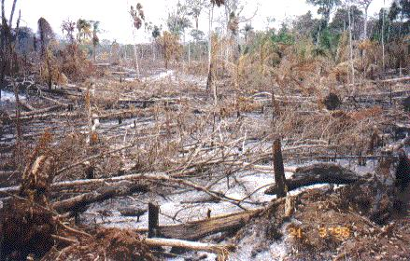
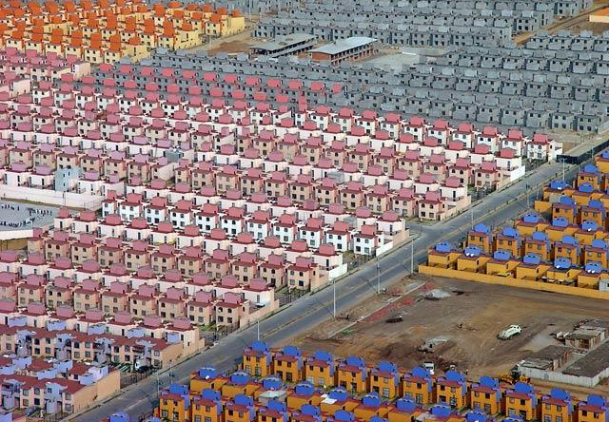
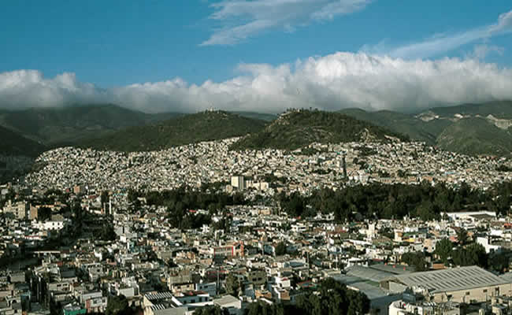
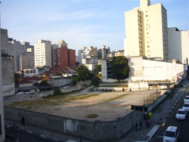
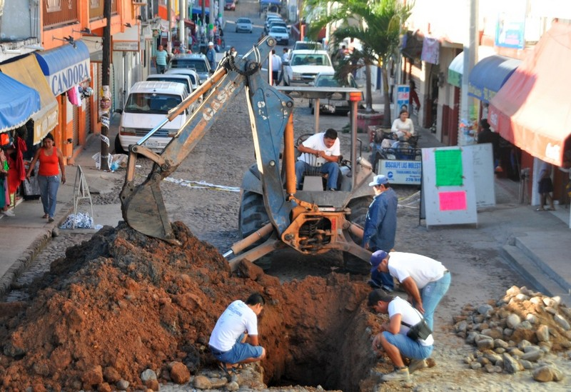
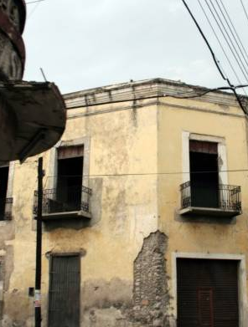
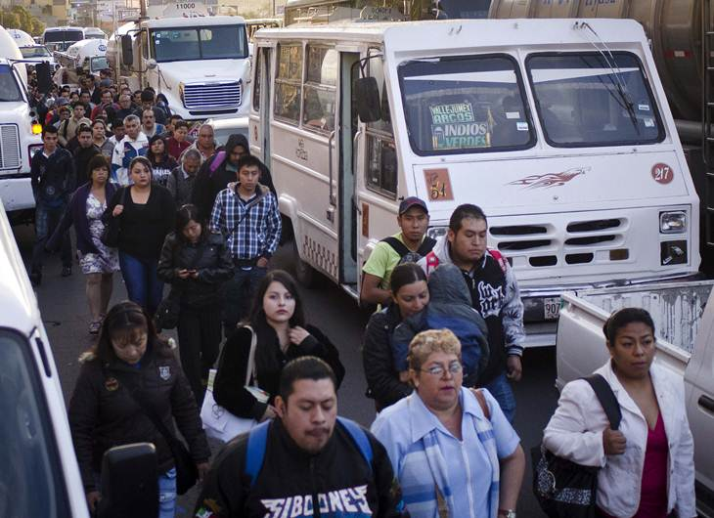
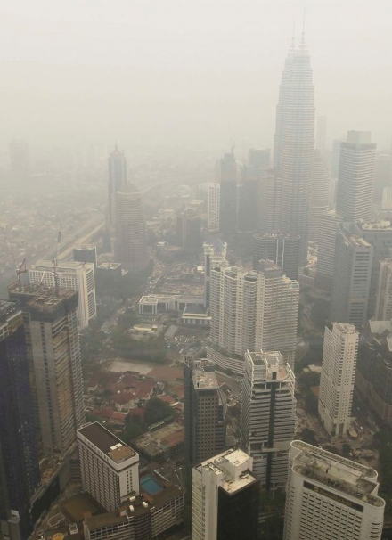
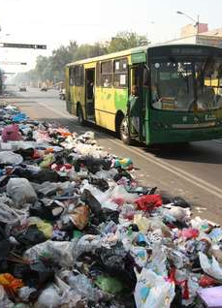
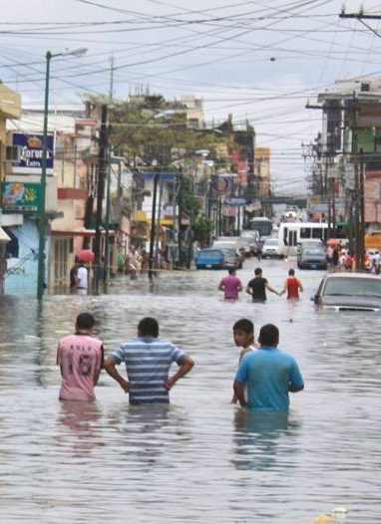
Land-use Change
Poor Housing Policy
Scattered Cities with Low Density
Underutilized Urban Land
Insufficient outdated infrastructure
Deteriorating housing stock
Sources of employment far from home
High Greenhouse Gas Emissions
Enviornmental deterioration and soil depredation
Vulnerability to natural phenomena
Notes:
traducción

Slide 15
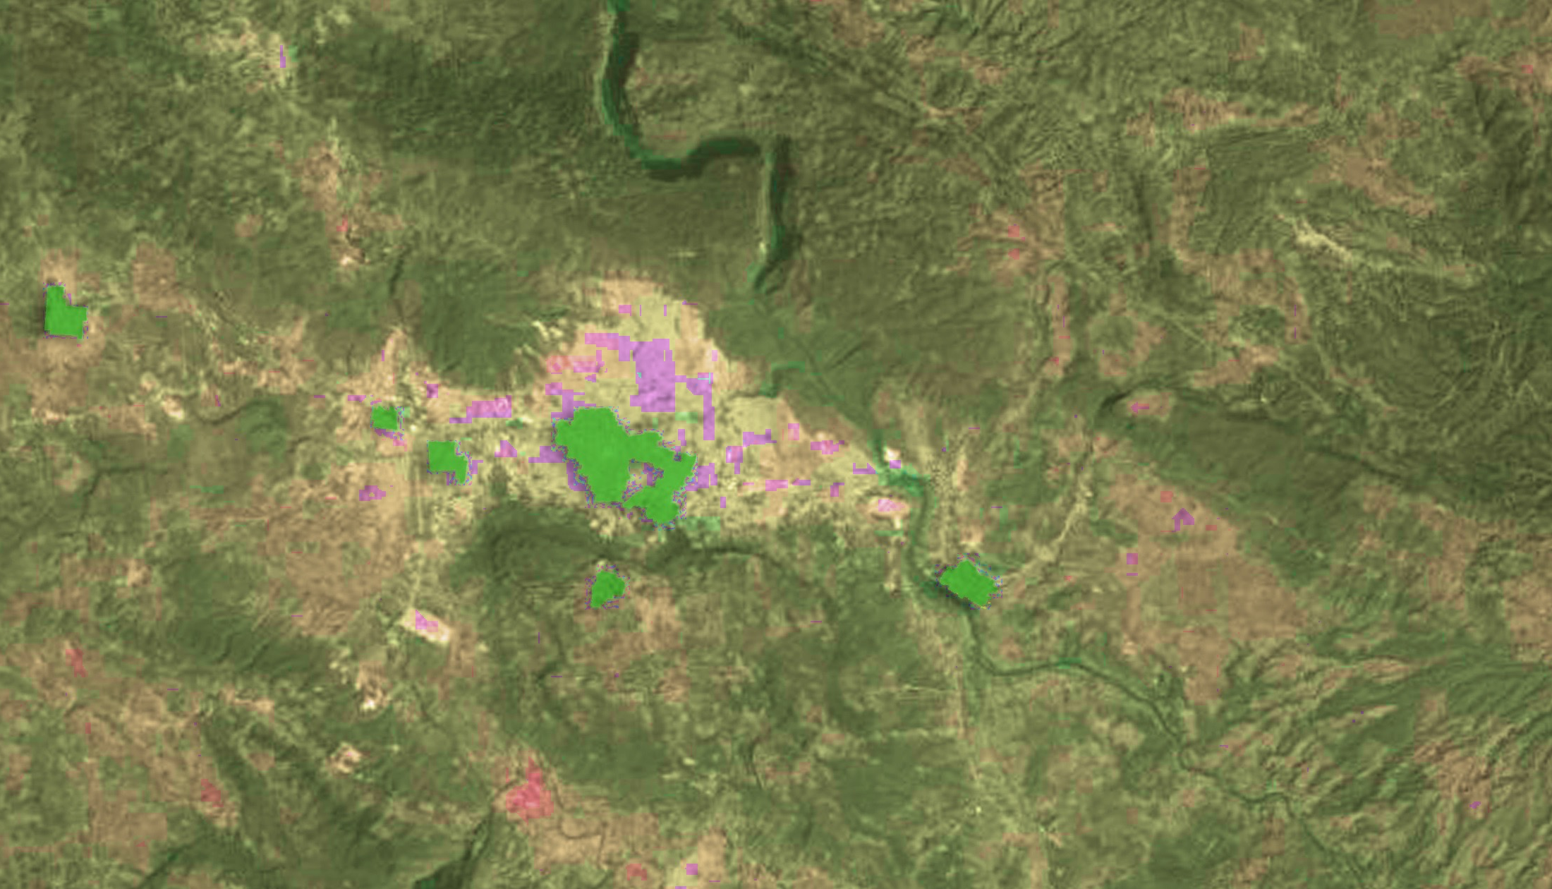
The expansion of the Mexican cities over the last 50 years has been massive and messy. Only over the last 30 years, the population in the cities duplicated, meanwhile the urban spots expanded 8 times. Hence the cities became dispair, with a low density of a 90.6% of horizontal housing stock and a average distribution of 23 houses per hectare.
196,785
Población
1980
Superficie urbana (Ha)
927
Tuxtla Gutiérrez, Chiapas
1980
Notes:
The expansión of the Mexican cities over the last 50 years has been massive and messy. Only over the last 30 years, the population in the cities duplicated, meanwhile the urban spots expanded 8 times. Hence the cities became dispair, with a low density of a 90.6% of horiztonal housing stock and a avreage distrubution of 23 houses per hecatre.

Slide 16
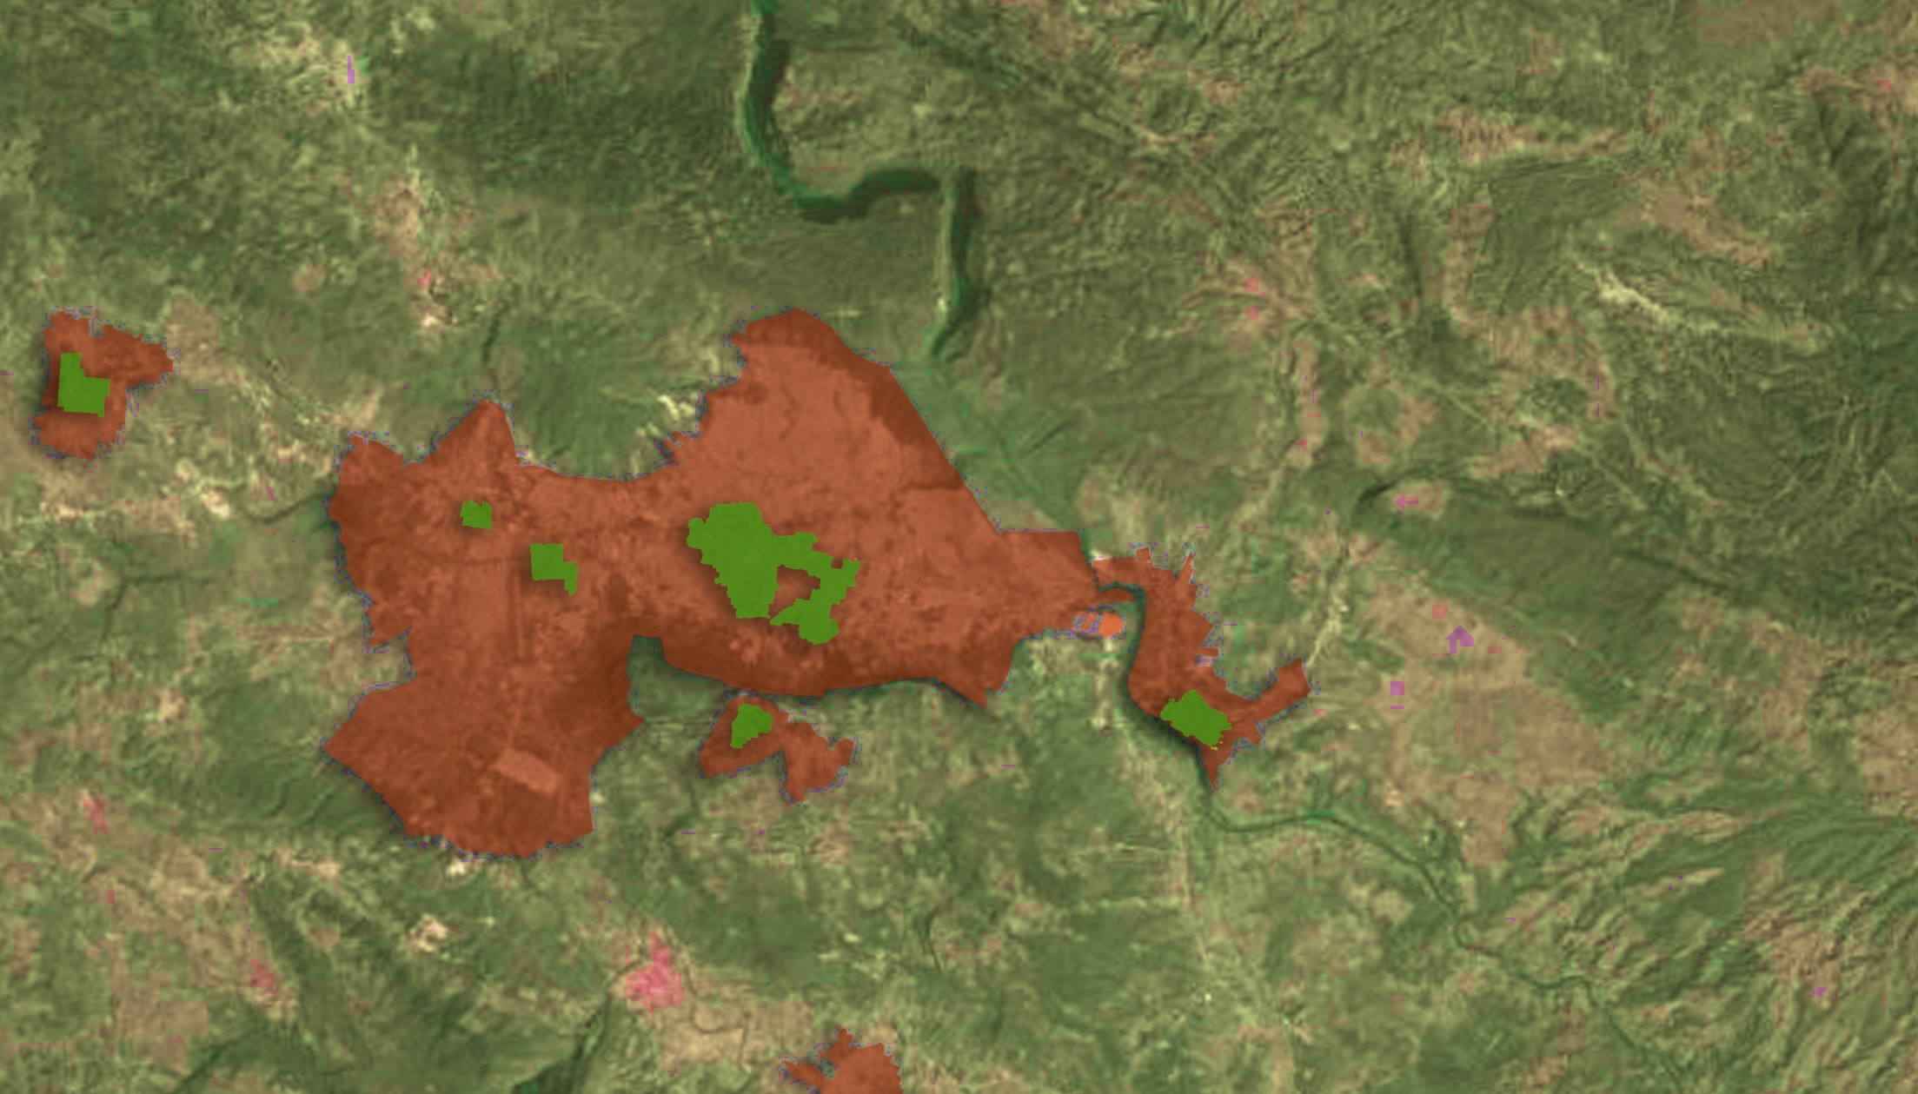
The expansion of the Mexican cities over the last 50 years has been massive and messy. Only over the last 30 years, the population in the cities duplicated, meanwhile the urban spots expanded 8 times. Hence the cities became dispair, with a low density of a 90.6% of horizontal housing stock and a average distribution of 23 houses per hectare.
684,156
3.48 veces
196,785
Población
1980
2010
14,145
15.26
veces
Superficie urbana (Ha)
927
Tuxtla Gutiérrez, Chiapas
1980
2010
Notes:
traducción

Slide 17
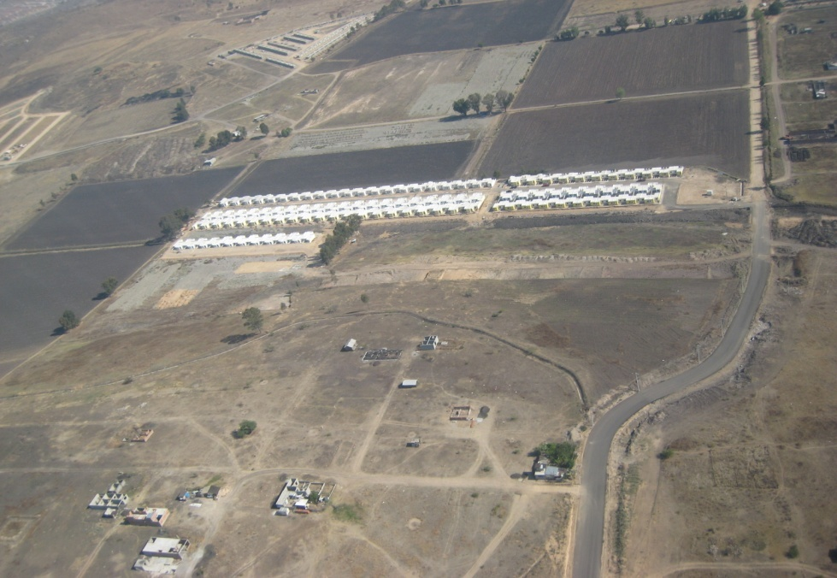
In recent years, this development model has generated
Low density housing
Underuse of urban equipment and infrastructure inside the city
Occupation of risky zones or with an ecological value for urban development Abandono de las viviendas
Housing abandonment
Notes:
In recent years, this development model has generated: Low density housing, Occupation of risky zones or with an ecological value for urban development

Slide 18
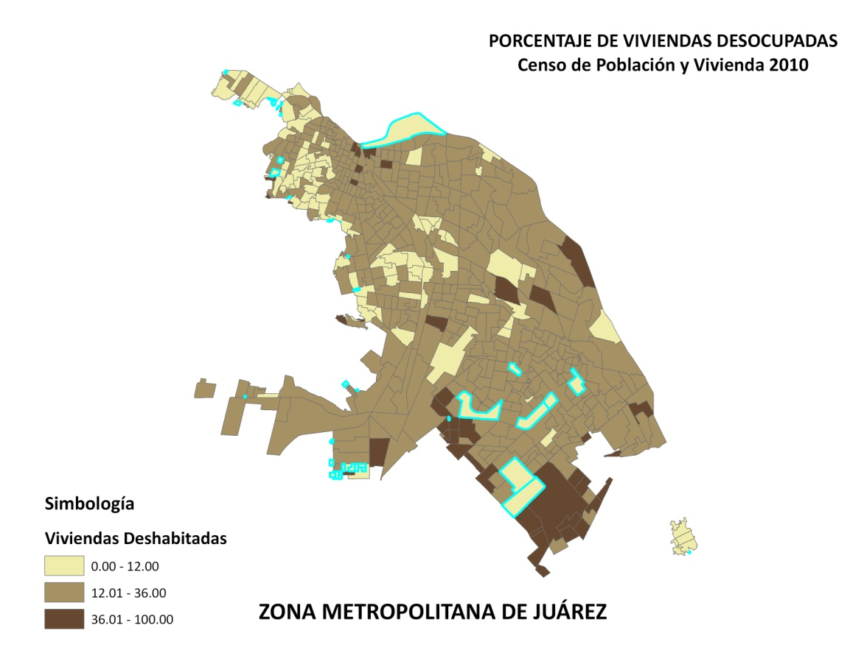
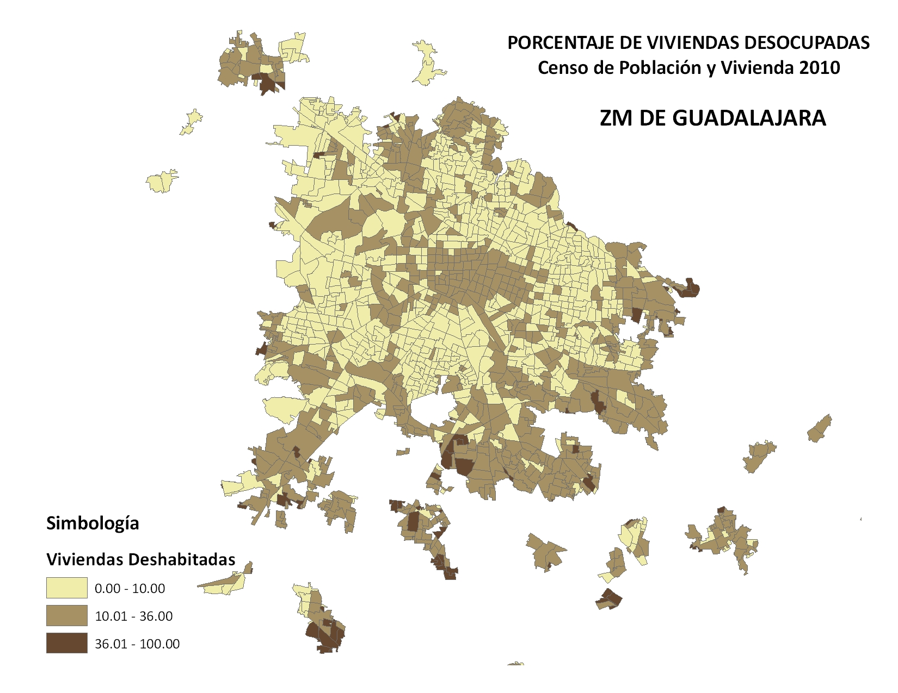
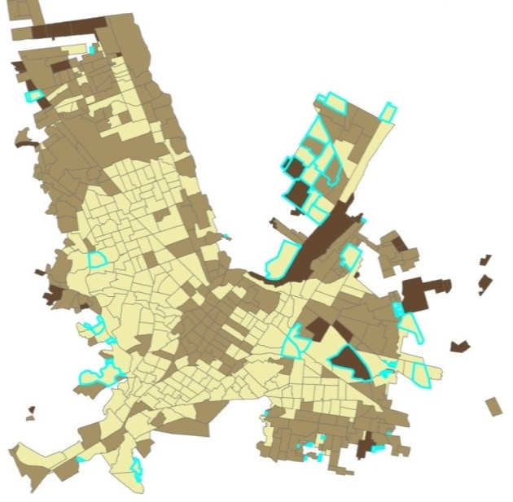
In Mexico there are 25.8 million houses, of which, 3.6 million (14%) are uninhabited.
Uninhabited houses are generally found in city centers or outskirts.
CHIHUAHUA
Z.M. DE GUADALAJARA
Notes:
In Mexico there are 25.8 million houses, of which, 3.6 million (14%) are uninhabited.
Uninhabited houses are generally found in city centers or outskirts.

Slide 19

Delivery Actions and
Strategies
MEXICO

Slide 20

The National Housing Policy is a
model focused on promoting the
orderly and sustainable
development of the sector, to
improve and regularize urban
housing; as well as to build and
improving rural housing

Slide 21
CITY
Resilient
Inclusive
Smart
Sustainable

Slide 22
objectives
highly efficient in resource consumption
greater comfort
within its urban and social environment
integrated vision
Transforming the way housing is built and equipped
quality of life and sustainability
should privilege urban planning and bioclimatic design
Human capital development
state and municipal government.

Slide 23









National
Sustainable
Housing
Policy
Notes:
Sustainable policy actors

Slide 24
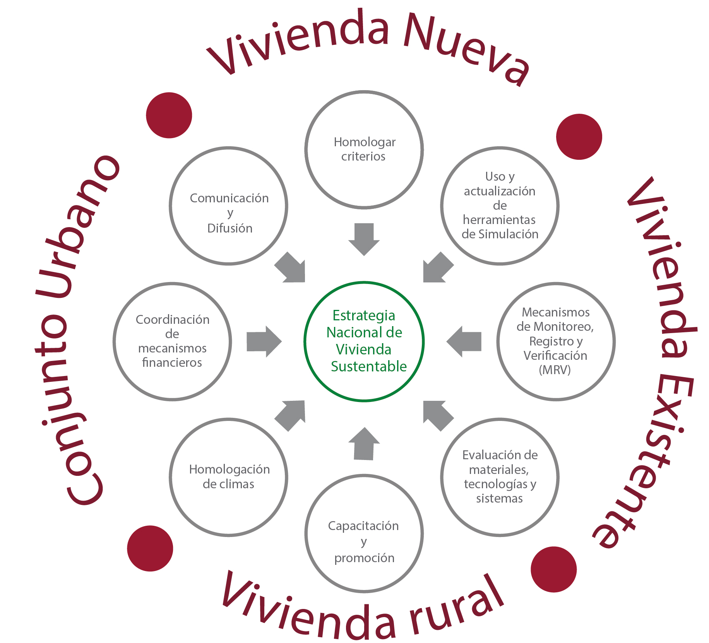
National housing and urban development policy
Estrategia Nacional de Vivienda Sustentable
National Sustainable Housing
Strategy
Sustainable housing cross-table
- Interdisciplinary work with different actors and specific goals
Challenges
Decent housing, sustainable and resilient
50% reduction of CO2 emissions by 2050
Notes:
Interdisciplinary work with different actors and specific goals50% reduction of CO2 emissions by 2050

Slide 25



MEXICO SUSTAINABLE HOUSING CHRONOLOGY
2001 - 2007
2008 - 2012
2013 - hoy
Concept
development
NAMA document and pilot projects
Sustainable housing strategy design and action
Creación CONAFOVI (CONAVI)
Proyecto piloto con ecos para paquete básico ROP y HV
Guías de diseño CONAVI
Implementación Hipoteca Verde
Código de Edificación de Vivienda
Creación de DUIS (DC)
Paquete básico CONAVI en ROP 2009
NMX-C-460-ONNCCE-2009
Pilotos NZEH en COP 16
Nuevo modelo de desarrollo urbano y vivienda, PCU
Hipoteca Verde Flexible
NAMA de Vivienda Sustentable
Mesa Transversal de Vivienda Sustentable
SISEViVe –Ecocasa en RUV
Programa Ecocasa (SHF)
Creación de SEDATU
ROP CONAVI: Prelación subsidio a la NAMA
Construcción de primeras Ecocasa
NAMA Facility Fund
NAMA de Vivienda Existente
Sensibilización y Capacitación al sector (público, privado)
Pilotos NAMA / NF
Homologación programas de vivienda sustentable.
Masificación
(70,177 viviendas NAMA + Ecocasa)
Estrategia Nacional de Vivienda Sostenible
Diseño e implementación a través de la Mesa Transversal de Vivienda Sustentable
Notes:
Portada _Smart cities around the world
PRIVATE SECTOR

Slide 26
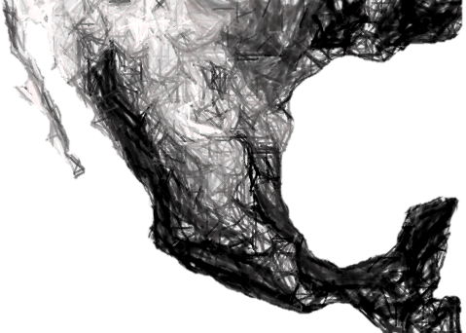
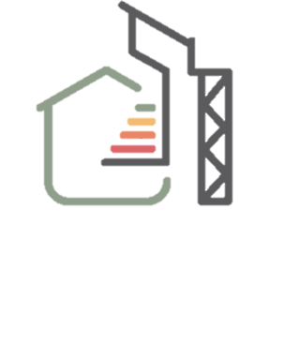


77,914
Houses
44,017.31
Ton per Year
$128’510,977.61
Economic Savings
Notes:
Portada _Smart cities around the world
PRIVATE SECTOR

Slide 27
You can observe a considerable rise between 2015 and 2016, with a stabilization between 2017 and 2018
The implementation of the NAMA mechanism increased considerably the amount of registered sustainable housing
Estimated sustainable housing
Sustainable housing national strategy
Notes:
You can observe a considerable rise between 2015 and 2016, with a stabilization between 2017 and 2018

Slide 28
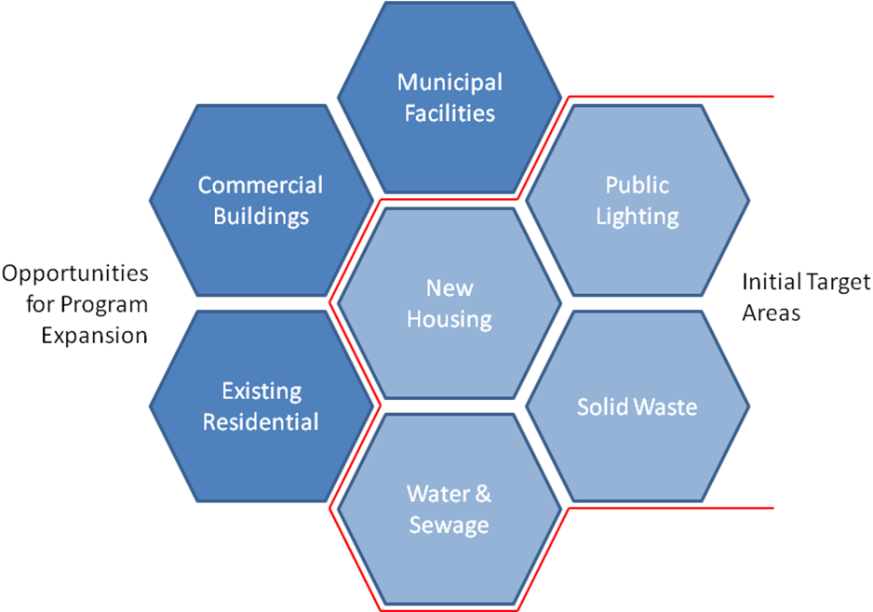
Urban NAMA Concept
    To reduce demand for delivered services,
    To improve the emissions efficiency of delivered services.
NAMA boundary by Sector
“Umbrella Concept”
    Total energy
    Fuel consumption
    Water consumption
at the community level
Notes:
Portada _Smart cities around the world
PRIVATE SECTOR

Slide 29
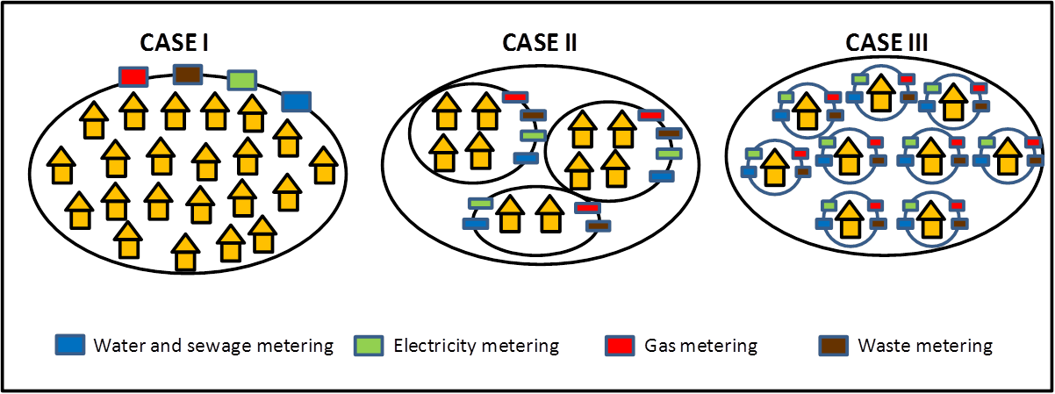
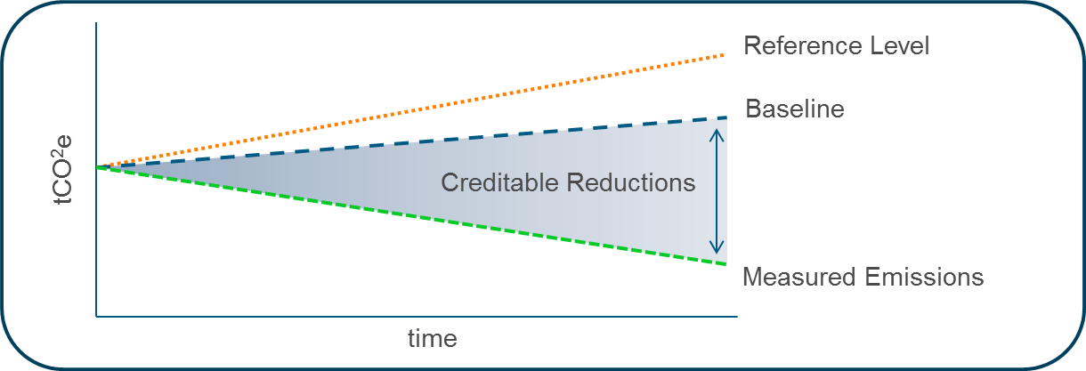
URBAN NAMA – pilot implementation
Simplified monitoring and reports actions
Reference level vs acreditable mitigation
Notes:
Reference level vs acreditable mitigation

Slide 30
Second strategy:
Move towars a Smart, Sustainable urban development model.
The Government will use the housing funding to orientate the country’s urban and territorial development
Public funding will contribute to elevating cities quality of life, promoting urban spaces renewal, redensification, as well as vertical housing and certified developments construction.
“… We need to avoid urban sprawling, wich makes it unviable and unsustainable for many people to move in and out of their places of residence, adding to this a lack of basic services like transport or security. “
Notes:
The Government will use the housing funding to orientate the country’s urban and territorial development
Public funding will contribute to elevating cities quality of life, promoting urban spaces renewal, redensification, as well as vertical housing and certified developments construction.
“… We need to avoid urban sprawling, wich makes it unviable for many people to move in and out of their places of residence, adding to this a lack of basic services like transport or security. “

Slide 31
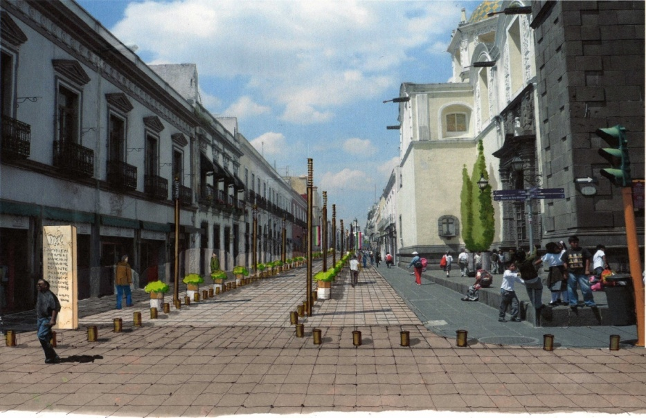
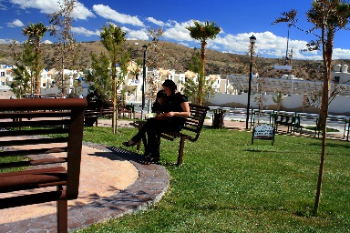
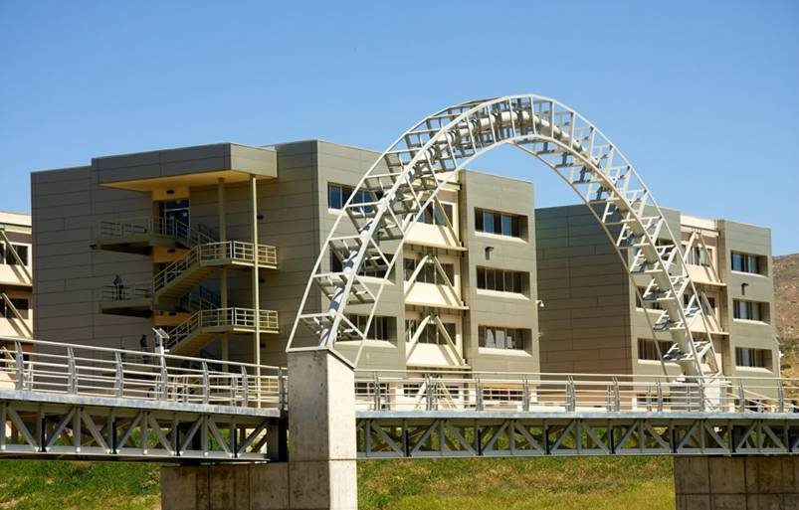
Certified Development types
INTRAURBAN
  Redensificación inteligente y uso de espacios intraurbanos. Todas las ciudades tienen en su interior lotes baldíos o subutilizados que pueden ser aprovechados.
1
Regeneración de la Ciudad de Puebla
  Proyectos que permiten el ensanche natural de la ciudad, dando continuidad a la mancha urbana existente.
  Se genera suelo servido aprovechando la cercanía de las infraestructuras y equipamientos y la accesibilidad que la propia zona urbana existente ofrece.
PERI - URBAN
2
Las Misiónes
  Esquema de generación de nuevos polos de desarrollo y nuevas comunidades.
  Proyectos urbanos que generan suelo servido con infraestructura, equipamientos, usos de suelo mixtos y fuentes de empleo.
NEW DEVELOPMENT POLES
3
Valle de San Pedro
Notes:
Portada _Smart cities around the world
PRIVATE SECTOR

Slide 32
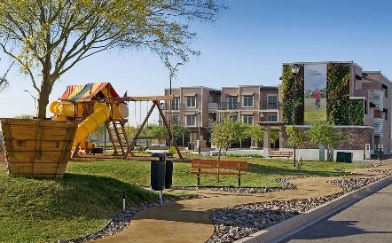
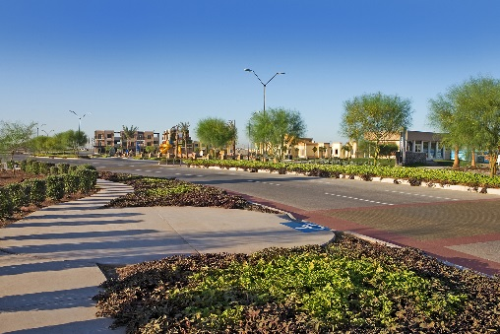
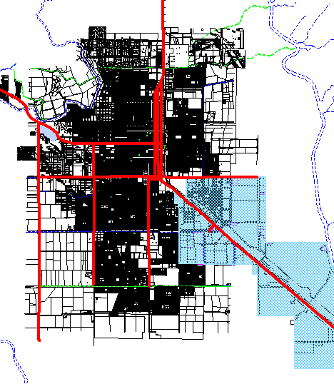
LAS MISIONES
  PROJECT TYPE
  Ensanche de Ciudad.
  SPONSOR
  LANDER
  LOCATION
  Ciudad Obregón, Cajeme, Son.
  PROJECT AREA
  102 ha.
  DEVELOPED HOUSES
  5,100 viviendas.
  20,400 Habitantes.
Notes:
Portada _Smart cities around the world
PRIVATE SECTOR

Slide 33
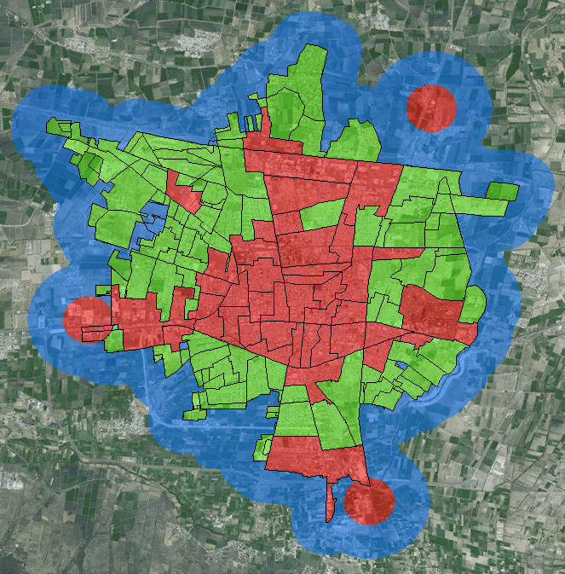
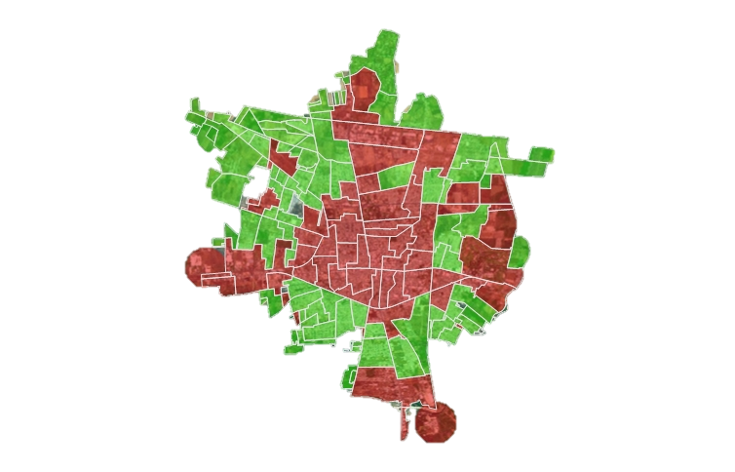
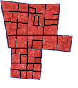
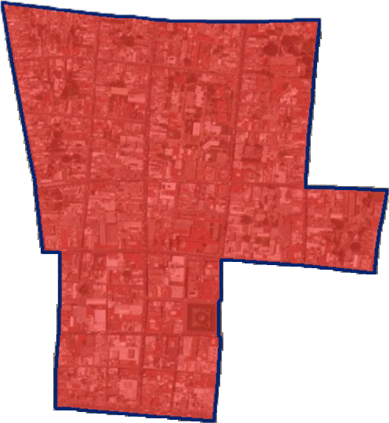
GEOSTATISTICAL MODEL FOR THE DEFINITION OF URBAN CONTAINMENT PERIMETERS (PCU)
URBAN AGEB
Manzanas
Una AGEB (Área Geoestadística Básica) urbana, es un área geográfica ocupada por un conjunto de manzanas perfectamente delimitadas por calles, avenidas, andadores o cualquier otro rasgo de fácil identificación en el terreno y cuyo uso del suelo es principalmente habitacional, industrial, de servicios, comercial, etcétera, y sólo son asignadas al interior de las localidades urbanas.
Inventario de Vivienda
Las AGEBs son la unidad de análisis básica y son la base de construcción de los PCU.
Los PCU están basados en todas las AGEBs urbanas de la ciudades que conforman el Sistema Urbano Nacional
Censos de Población y Vivienda
DENUE
Inventario de Vivienda
Notes:
GEOSTATICAL MODEL FOR THE DEFINITION OF URBAN CONTAINMENT PERIMETERS (PCU)

Slide 34
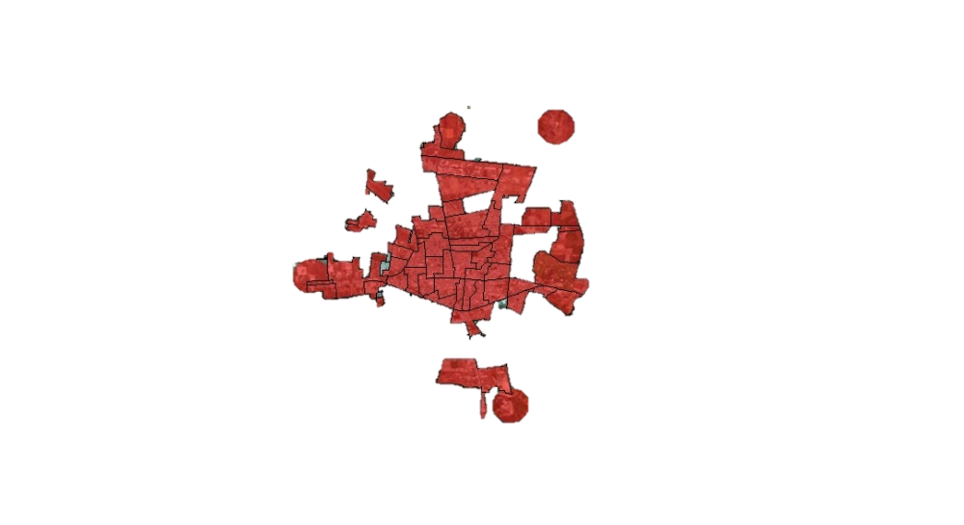
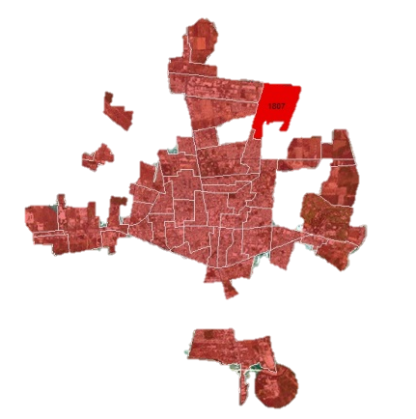

PCU U1
EMPLOYMENT ZONES
U1 a partir de AGEBS
Donde:
R_{i} es la razón personal ocupado-población
residente del AGEB i,
PO_{i} es el personal ocupado del AGEB i, calculado con base en los Censos Económicos 2009, Personal ocupado (total), comprende a todas las personas que trabajaron durante el periodo de referencia dependiendo contractualmente o no de la unidad económica, sujetas a su dirección y control,
Pr_{i} es la población residente del AGEB i, de acuerdo con el Censo de Población y Vivienda 2010,
i = 1,2,3,…,n son las AGEB´s de la ciudad en
cuestión.
POi
AGEB
∑POi
AGEB’s
AGEB
U1
Ri=
=
>
1
PRi
AGEB
∑PRi
AGEB’s
U1 a partir de Puntos de DENUE
1. Más de 250 empleos en la orilla de la ciudad y fuera de AGEB
2. Aglomeraciones económicas que suman más de 1000 empleos
Rango de población por número de habitantes de la ciudad SUN |  |  |  | Radio de Influencia
Más de | 1,000,000 |  |  | 800
De | 500,000 | a | 999,999 | 700
De | 100,000 | a | 499,999 | 600
De | 50,000 | a | 99,999 | 500
Menor | 50,000 |  |  | 400
Rango de población por número de habitantes de la ciudad SUN |  |  |  | Radio de Influencia
Más de | 1,000,000 |  |  | 400
De | 500,000 | a | 999,999 | 350
De | 100,000 | a | 499,999 | 300
De | 50,000 | a | 99,999 | 250
Menor | 50,000 |  |  | 200
Con radio y envolvente U3 al mismo tamaño
Con radio y envolvente U3 al mismo tamaño
Notes:
Data

Slide 35
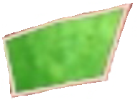

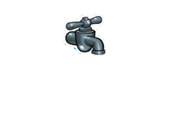


PCU U2
SERVICES ZONES
AGEB
U2
Los PCU U2, son AGEBs que cuentan con servicios e infraestructura y que al estar en AGEBs, se encuentran dentro de las zonas urbanas.
Sólo en AGEBs
Los U2, responden a la existencia de 4 condiciones básicas:
que exista U1 de AGEBs
+
Densidad
> 20 Viv/ha
La densidad deberá ser mayor a 20 viviendas por hectárea en la AGEB
+
> 75%
Agua
De total de viviendas en la AGEB, por lo menos el 75% deben tener agua dentro de la vivienda
+
No puede haber U2 si no hay U1
> 75%
Drenaje
De total de viviendas en la AGEB, por lo menos el 75% deben tener drenaje
Notes:
Data

Slide 36
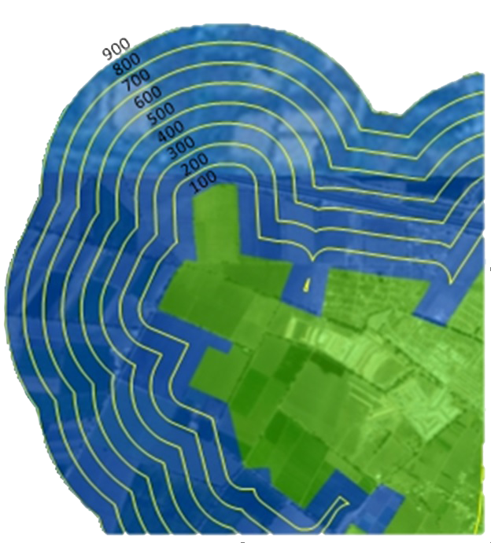
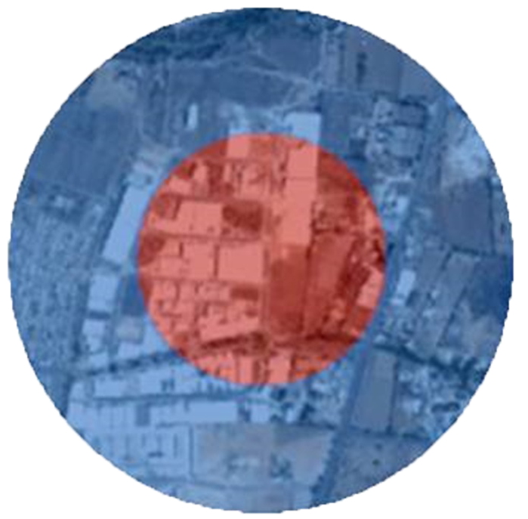
PCU U3
EXPANSION ZONES AND GROWTH CONTAINMENT CLOSE TO URBAN AREAS
Quedan conformadas por un buffer o envolvente que cubre los contornos U1 y U2
De acuerdo con el rango de población de la ciudad se determina el perímetro de expansión
Constituye un borde virtual de contención del crecimiento de las ciudades
Rango de población por número de habitantes de la ciudad SUN |  |  |  | Distancia máxima del perímetro de U1 y U2 al límite del buffer
Más de | 1,000,000 |  |  | 900m
De | 500,000 | a | 999,999 | 800m
De | 100,000 | a | 499,999 | 700m
De | 50,000 | a | 99,999 | 600m
Menor | 50,000 |  |  | 500m
Rango de población por número de habitantes de la ciudad SUN |  |  |  | Radio de Influencia
Más de | 1,000,000 |  |  | 400
De | 500,000 | a | 999,999 | 350
De | 100,000 | a | 499,999 | 300
De | 50,000 | a | 99,999 | 250
Menor | 50,000 |  |  | 200
A partir de los puntos de DENUE identificados como U1, se crean los radios de influencia al mismo tamaño del radio.
Notes:
Data

Slide 37




DATA
Notes:
Data

Slide 38
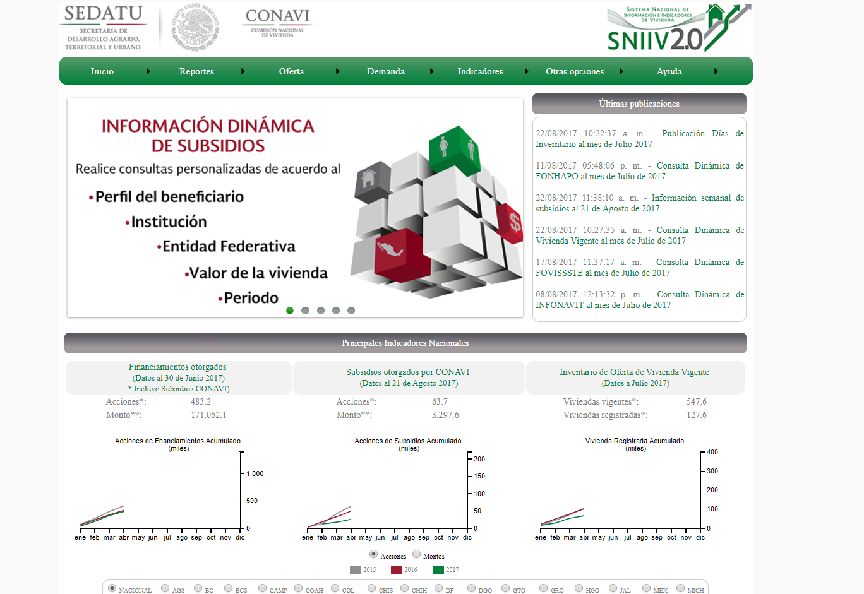
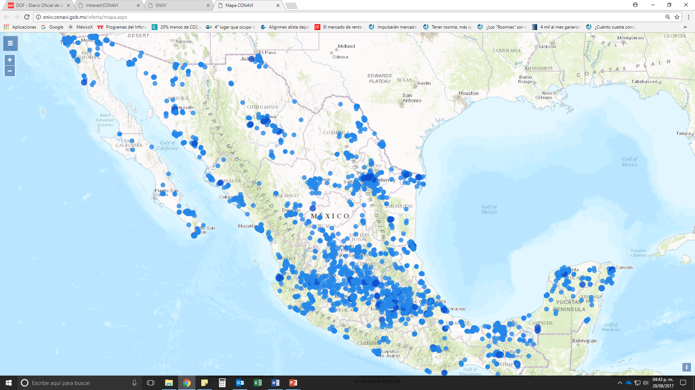
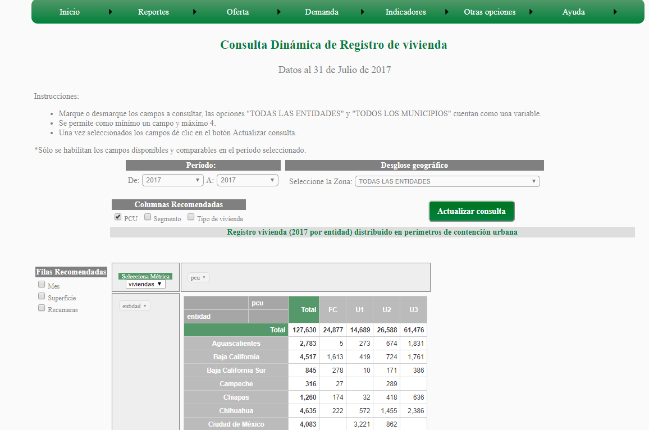
Sistema Nacional de Información e Indicadores de Vivienda (SNIIV)
Compile, Generate and Distribute the required information for the adequate planning, based with instrumentation and following the National Housing Policy, reinforcing the articulated offering of housing in the country

Slide 39
SNIIV 2.0
Subsidios
Reserva territorial
Perfil del beneficiario
Reporte mensual: reporte, presentación, videoconferencia
Reportes temáticos: empleo, oferta en RUV, etc.
Ubicación geográfica en SIG
Vivienda en construcción y terminada
Actualización semanal
Revista trimestral
Tiempos de desplazamiento
Atributos de la vivienda
Cobertura municipal y por organismo
Perímetros de Contención Urbana en SIG
Superficie registrada
A nivel municipio
Aplicación móvil
Avance de financiamientos y subsidios
Detalle por municipio y PCU
Consultas interactivas
Modalidad
Perfil del comprador
Oferta de vivienda
Análisis
Financiamiento
Oferta de vivienda
APP

Slide 40
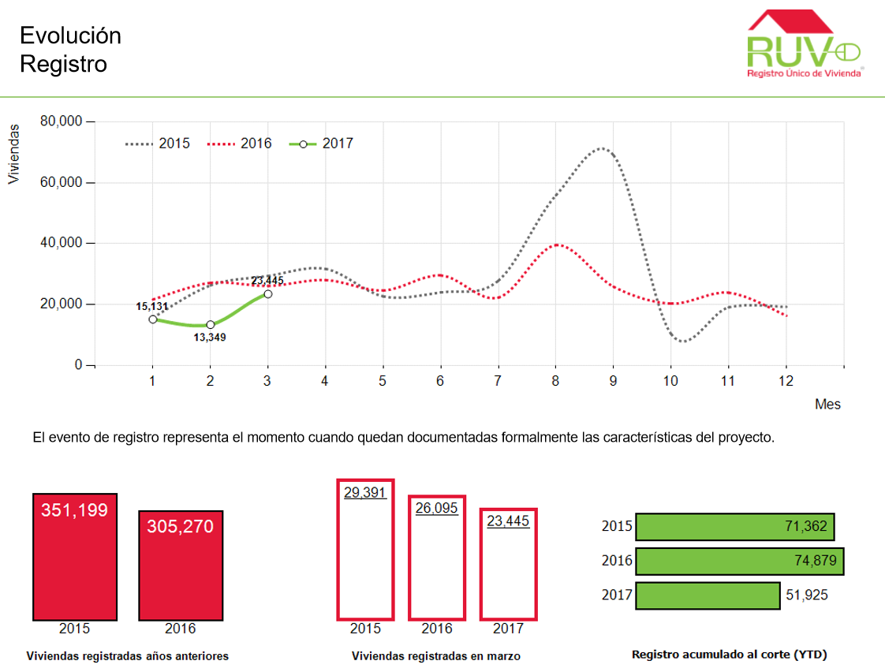

Slide 41
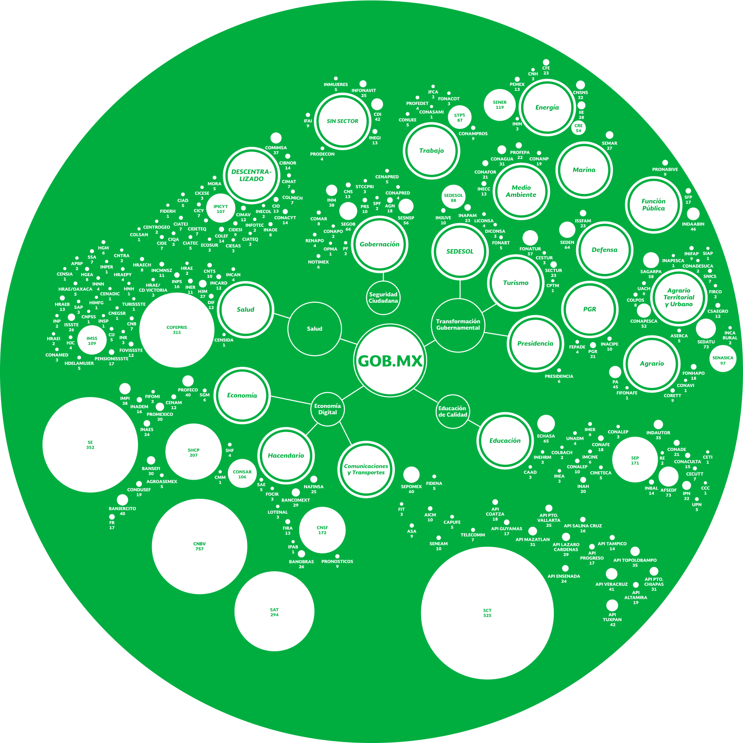

The National Digital Strategy is an national action plan which encourages the development of México towards a transformation into a Digital Government “México Digital”
Notes:
En voz complementar: en el que la tecnología y la innovación contribuyan a alcanzar las grandes metas de desarrollo del país

Slide 42
Digital Economy
Effective and Universal healt
Government Transformation
Civic Innovation and Citizen Participation
Educational Tranformation
The main goals
of this Strategy
are:

Slide 43






Smart City definitions should be a “work in progress” cognitive, social and democratic process
Technology and data are the medium not the end
Smart City definitions can’t be “one size fits all” or imposed. They evolve, adapt and learn.
Smart Citizens are absolutely essential for achieving the transformation into a Smart City
We are far from having a Smart City despite actions and policies, we need Smart citizens to remember why we chose to live in communities/cities as an endless source of opportunity.
Final Thoughts
Conclusions
Tomasz Dominik Kotecki
General Deputy Director for Housing Analysis, Foresight
and Sustainability
@koteckitomasz

