Slide 1

ASEAN Community:
An Overview
Draft Presentation Templates
July 2015

Slide 2
ASEAN Overview
Notes:
This section contains slides which can be used to talk about ASEAN in general.

Slide 3
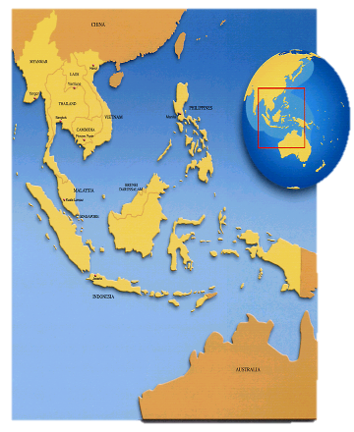
ASEAN
Association of Southeast Asian Nations
10 Member States:
Brunei Darussalam (7 January 1984)
Cambodia (30 April 1999)
Indonesia (8 August 1967)
Lao PDR (23 July 1997)
Malaysia (8 August 1967)
Myanmar (23 July 1997)
Philippines (8 August 1967)
Singapore (8 August 1967)
Thailand (8 August 1967)
Viet Nam (28 July 1995)

Slide 4
ASEAN Vision
“A concert of Southeast Asian nations, outward looking, living in peace, stability and prosperity, bonded together in partnership in dynamic development and in a community of caring societies.”

Slide 5
ASEAN Aims and Purposes
(Bangkok Declaration 1967)
To accelerate the economic growth, social progress and cultural development in the region through joint endeavors
To promote regional peace and stability through abiding respect for justice and the rule of law

Slide 6
ASEAN Charter (“Constitution”)
Entered into force on 15 December 2008
Provides legal status and institutional framework for ASEAN
Codifies ASEAN norms, rules and values
Sets clear targets for ASEAN
Presents accountability and compliance
Committee of Permanent Representatives (CPR)
Convening of ASEAN Summit twice a year
Establishment of the ASEAN Intergovernmental Commission on Human Rights (AICHR)
Ambassadors to ASEAN
Notes:
The ASEAN Charter serves as a firm foundation in achieving the ASEAN Community by providing legal status and institutional framework for ASEAN. It also codifies ASEAN norms, rules and values; sets clear targets for ASEAN; and presents accountability and compliance.
The ASEAN Charter entered into force on 15 December 2008. A gathering of the ASEAN Foreign Ministers was held at the ASEAN Secretariat in Jakarta to mark this very historic occasion for ASEAN.
With the entry into force of the ASEAN Charter, ASEAN will henceforth operate under a new legal framework and establish a number of new organs to boost its community-building process.
In effect, the ASEAN Charter has become a legally binding agreement among the 10 ASEAN Member States. It will also be registered with the Secretariat of the United Nations, pursuant to Article 102, Paragraph 1 of the Charter of the United Nations.

Slide 7
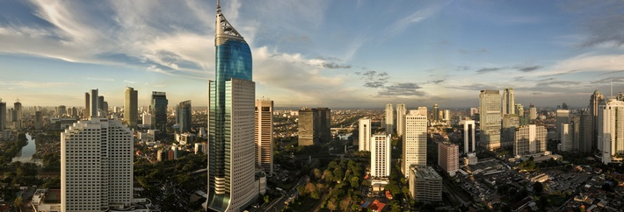
If ASEAN were a single country, it would already be the seventh-largest economy in the world, with a combined GDP of $2.4 trillion in 2013.
It is projected to rank as the fourth-largest economy by 2050.
McKinsey & Co. – May 2014
Notes:
Population: 616,613,651 (2012)
Land area: 4,435,618 sq. km.
GDP: US$ 2.395 trillion (2014) and GDP per capita USD 3,832
Trade: US$ 2.51 trillion (2014) -- Exports = USD 1,271,128 Million; Imports = USD 1,240,388 Million
Foreign Direct Investment (FDI): US$ 122.4 billion (2013)
Latest statistics revealed that in general, ASEAN economies remained buoyant as nominal Gross Domestic Product (GDP) grew by 5.2 percent at US$ 2.4 trillion in 2013 from 2.3 trillion in the previous year. The continued economic growth is partly reflected in the improved GDP per capita at US$ 3,834 from US$ 3,781 in 2012.
On the other hand, ASEAN’s real GDP growth in 2013 was slightly lower by 0.7 percentage point at 5.2 percent compared to 2012. ASEAN5’s (Indonesia, Malaysia, Philippines, Singapore and Thailand) combined growth was recorded at 4.1 percent during the third quarter of 2014 from 5.1 percent during the same period in 2013, partly driven by adverse economic developments in Brunei Darussalam and Thailand.
Source : ASEAN Stats

Slide 8
Gross Domestic Product 2014
COUNTRIES | GDP
United States China Japan Germany United Kingdom France Brazil Italy India Russia Federation Indonesia (16) World | 17,419,000 10,360,105 4,601,461 3,852,556 2,941,886 2,829,192 2,346,118 2,144,338 2,066,902 1,860,598 888,538 77,868,768
ASEAN
USD 2.48 trillion
Source: World Development Indicators, The World Bank (As of 1 July 2015)
Notes:
Table has been updated with 2014 figures from World Bank
(As of 01 July 2015)
http://data.worldbank.org/data-catalog/GDP-ranking-table
Indonesia: 888,538
Thailand: 373,804
Malaysia: 326,933
Singapore: 307,872
Philippines: 284,582
Vietnam: 186,205
Myanmar: 64,330
Brunei Darussalam: 17,257
Cambodia: 16,709
Lao PDR: 11,772
TOTAL: 2,478,002

Slide 9
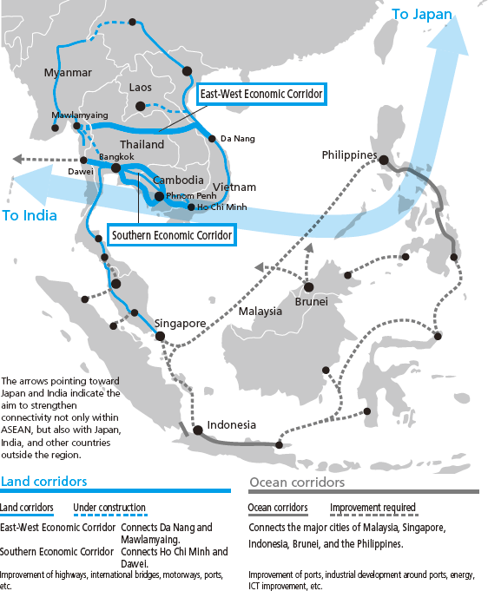
ASEAN
Highly connected: Physically, Institutionally and among the Peoples
Free trade agreements with major regional economies
Young, educated labour force
Notes:
Highly connected region: Indonesia’s mobile phone penetration: 109%; Bangkok is the Facebook capital of the world; 81% of Vietnamese use social media; Philippines has 30 million Facebook users
Young educated labour force: youth aged 15-29 account for 27% of ASEAN’s population; they are mostly educated and tech savvy
ASEAN signed FTAs with China, Japan, South Korea, India, New Zealand and Australia.
WHY AN ASEAN COMMUNITY?
Need to intensify political cooperation, strengthen peace and security in Southeast Asia
Enhance economic competitiveness of individual Member States, and of ASEAN as regional market and production base for global economic competition
Need to narrow the development gaps
Need to respond effectively to transnational threats to human security and new challenges in the 21st century
Harness human resources and benefit from rich cultural diversity in the ASEAN region
Gain international recognition and support for community-building

Slide 10
ASEAN Community Building
Notes:
This section has slides which can be used to talk about the ASEAN Community and its history.

Slide 11
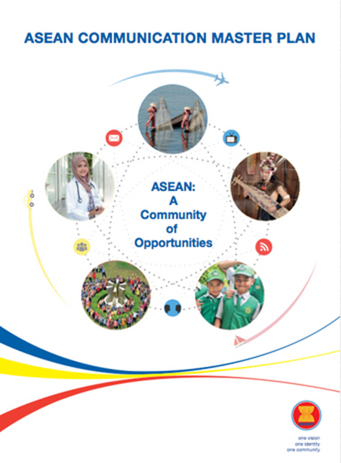
A Community of Opportunities

Slide 12
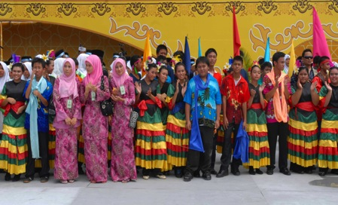
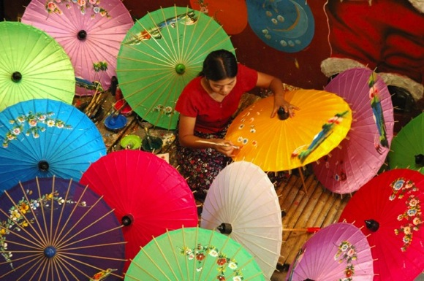
ASEAN: A Community of Opportunities
Huge Market:
625 million+ people
GDP:
USD 2.4 trillion
Courtesy of ASEAN National Tourism Organisations
FDI:
USD 122.4 billion
Steady economic growth rate
Courtesy of ASEAN National Tourism Organisations
ROBUST
Notes:
Population: 616,613,651 (2012)
Land area: 4,435,618 sq. km.
GDP: US$ 2.395 trillion (2014) and GDP per capita USD 3,832
Trade: US$ 2.51 trillion (2014) -- Exports = USD 1,271,128 Million; Imports = USD 1,240,388 Million
Foreign Direct Investment (FDI): US$ 122.4 billion (2013)
Latest statistics revealed that in general, ASEAN economies remained buoyant as nominal Gross Domestic Product (GDP) grew by 5.2 percent at US$ 2.4 trillion in 2013 from 2.3 trillion in the previous year. The continued economic growth is partly reflected in the improved GDP per capita at US$ 3,834 from US$ 3,781 in 2012.
On the other hand, ASEAN’s real GDP growth in 2013 was slightly lower by 0.7 percentage point at 5.2 percent compared to 2012. ASEAN5’s (Indonesia, Malaysia, Philippines, Singapore and Thailand) combined growth was recorded at 4.1 percent during the third quarter of 2014 from 5.1 percent during the same period in 2013, partly driven by adverse economic developments in Brunei Darussalam and Thailand.
Source : ASEAN Stats

Slide 13
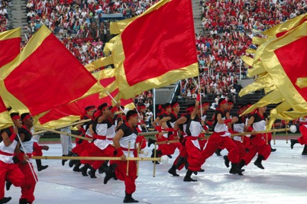

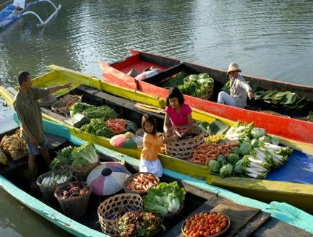
ASEAN: A Community of Opportunities
Highly Connected Region
Young, educated labour force
Courtesy of ASEAN National Tourism Organisations
Free Trade Agreements with major regional economies
Image source: Flickr.com/RussellGilbert
Courtesy of ASEAN National Tourism Organisations
DYNAMIC

Slide 14



ASEAN: A Community of Opportunities
Home to major religions
Rich culture
Courtesy of ASEAN National Tourism Organisations
Vast natural
resources
Courtesy of ASEAN National Tourism Organisations
Courtesy of ASEAN National Tourism Organisations
DIVERSE

Slide 15
ASEAN Community Building
ASEAN:
A people-oriented community
    ASEAN
    Political-Security
    Community
    (APSC)
    ASEAN
    Economic
    Community
    (AEC)
    ASEAN
    Socio-Cultural
    Community
    (ASCC)
Narrowing the Development Gap (NDG)
Notes:
ASEAN Political Security Community (APSC)
Ensures that the peoples and Member States of ASEAN live in peace with one another and with the world at large in a just, democratic and harmonious environment.
ASEAN Economic Community (AEC)
Transforms ASEAN into a stable, prosperous, and highly competitive region with equitable economic development, and reduced poverty and socio-economic disparities.
ASEAN Socio-Cultural Community (ASCC)
Contributes to realising an ASEAN Community that is people-oriented and socially responsible with a view to achieving enduring solidarity and unity among the peoples and Member States of ASEAN.
Narrowing the Development Gap (NDG)
Progressing together through cooperation in development.

Slide 16
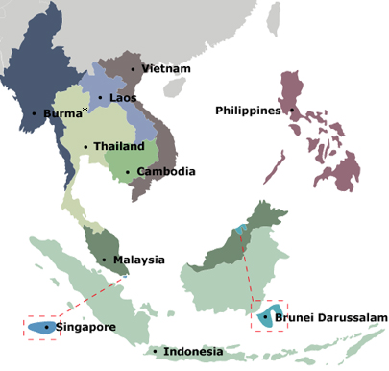
The ASEAN Journey to Community Building
1967
Bangkok Declaration
1997
ASEAN Vision 2020
2003
Bali Concord II
2007
Cebu Declaration
2015
Dec 31st
Realisation of the ASEAN Community
Notes:
1967: Bangkok Declaration
“Accelerate the economic growth, social progress and cultural development in the region through joint endeavors.”
“Promote regional peace and stability through abiding respect for justice and the rule of law.”
1997: ASEAN Vision 2020
“ASEAN as a concert of Southeast Asian nations, outward looking, living in peace, stability and prosperity, bonded together in partnership in dynamic development and in a community of caring societies.”
2003: Bali Concord II
“An ASEAN Community shall be established comprising three pillars, namely political and security cooperation, economic cooperation, and socio-cultural cooperation…”
2007:12th ASEAN Summit
Cebu, Philippines
“Accelerate the establishment of an ASEAN Community by 2015…”

Slide 17
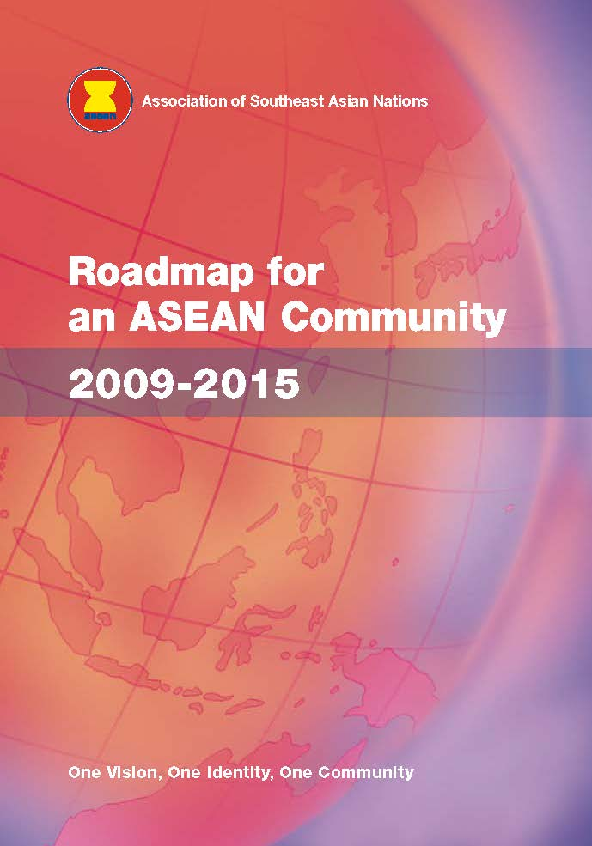


The ASEAN Journey to Community Building
Strengthening Framework of ASEAN Integration
ASEAN Charter
Roadmap for an ASEAN Community
2009-2015
Master Plan on ASEAN Connectivity
2008
2009
2010

Slide 18
ASEAN Political-Security Community
Draft Slide Templates
July 2015
Notes:
Core pillar colour: shades of red

Slide 19
APSC Blueprint
Political Cooperation
Security Cooperation
External Relations
A rules-based community of shared values & norms
A cohesive, peaceful, stable & resilient region with shared responsibility for comprehensive security
A dynamic and outward-looking region in an increasingly integrated and interdependent world

Slide 20
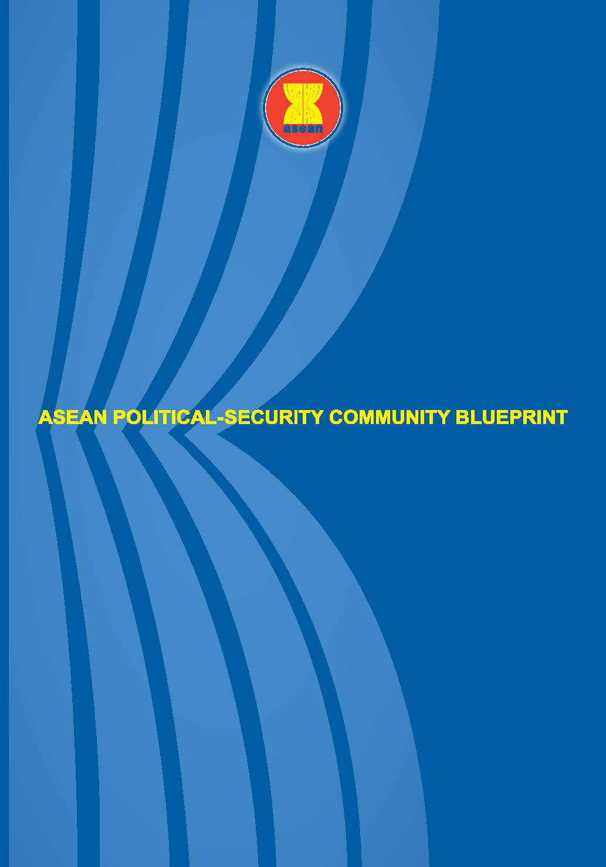
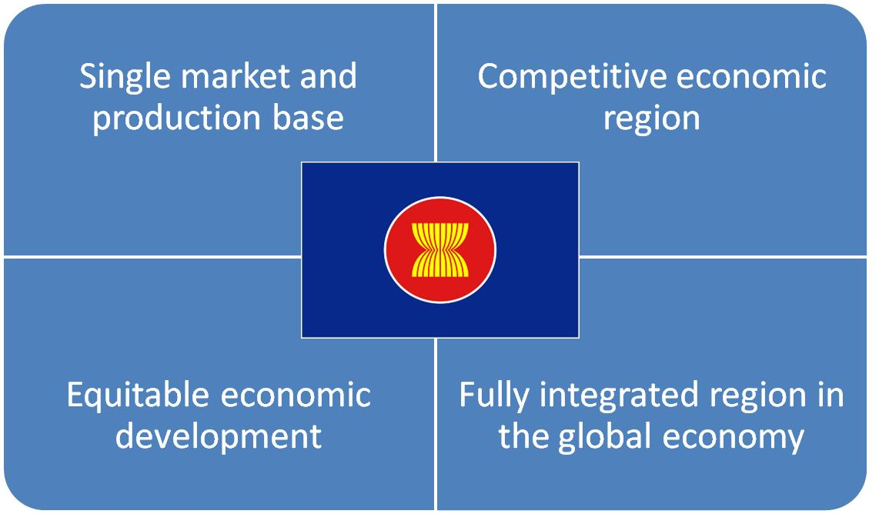
APSC Community-Building Mandate
People live in peace
Relations between ASEAN & Dialogue Partners
Maintain centrality
Open, transparent & inclusive
Notes:
Ensure that the peoples and Member States of ASEAN live in peace with one another and with the world at large
Strengthen the mutually beneficial relations between ASEAN and its Dialogue Partners and friends
Maintains the centrality and proactive role of ASEAN in a regional architecture that is open, transparent and inclusive, while remaining actively engaged, forward-looking and non-discriminatory

Slide 21
ASEAN Sectoral Bodies Under the APSC
ASEAN Summit
ACC
APSC Council
ARF
SEANWFZ Commission
ADMM
ADSOM
ARF SOM
Executive Committee of the SEANWFZ Commission
AMM
SOM
AICHR
AMMTC
SOMTC
DGICM
ASOD
ALAWMM
ASLOM
Reporting Line
Coordinating
Notes:
ASEAN Regional Forum (ARF)
ASEAN Defence Ministers’ Meeting (ADMM)
Commission on the Southeast Asia Nuclear Weapon-Free Zone (SEANWFZ Commission)
ASEAN Foreign Ministers (AMM)
ASEAN Ministerial Meeting on Transnational Crime (AMMTC)
ASEAN Law Ministers’ Meeting (ALAWMM)

Slide 22
APSC Community-Building Milestones
Treaty of Amity and Cooperation
78 non-ASEAN Member States & organisations have accredited their Ambassadors to ASEAN
42 ASEAN Committees in Third Countries to raise ASEAN awareness and profile
Notes:
International recognition of the Treaty of Amity and Cooperation as a key code of conduct for inter-state relations in the region has grown remarkably. The TAC now has 32 High Contracting Parties

Slide 23
Ongoing Work in APSC Pillar
ASEAN Community’s Vision 2025
Timor-Leste’s Application for ASEAN Membership
South China Sea
SEANWFZ Protocol
Women & children: ACTIP & RPA
Transnational crime & violent extremism: AMMTC
Notes:
Formulating ASEAN Community’s Vision 2025 and the attendant document of the 3 Community pillars for 2016-2025. It will be submitted to the 27th ASEAN Summit in 2015 for adoption.
Study on Timor-Leste’s Application for ASEAN Membership and its implications on ASEAN Political-Security Community Building.
Full and effective implementation of the Declaration of the Conduct of Parties in the South China Sea (DOC) in its entirety, as well as to work towards the early conclusion of the Code of Conduct in the South China Sea (COC) based on consensus.
Renewed consultations with the Nuclear Weapon States on the outstanding issues related to the signing of the SEANWFZ Protocol
Finalisation of the ASEAN Convention of Trafficking in Persons Especially Women and Children (ACTIP) and the ASEAN Regional Plan of Action Especially Women and Children (RPA)
Preparation for the Special Ministerial Meeting on the Rise of Radicalisation and Violent Extremism, back-to-back with the 10th ASEAN Ministerial Meeting on Transnational Crime (AMMTC) on 28- Sept – 2 Oct 2015 in Melaka, Malaysia
Preparation for the AMMTC Emergency Meeting on the Issue of Irregular Movement of People in Southeast Asia on the end of June 2015, in Malaysia

Slide 24

Post-2015 Vision for APSC
“An ASEAN Political-Security Community where peace, stability and security prevail and the peoples live in a safe and secured environment, with shared principles, values and norms, with enhanced external relations in depth and scope, strengthened ASEAN’s centrality in the regional architecture, and an ASEAN common platform on global issues.”
From the Nay Pyi Taw Declaration on
the ASEAN Community’s Post-2015 Vision
12 November 2014

Slide 25
ASEAN Economic Community
Draft Slide Templates
July 2015
Notes:
Core pillar colour: shades of blue

Slide 26
AEC Overview
Mandate, Blueprint & Milestones

Slide 27
AEC Blueprint: Adopted Nov 2007
ASEAN ECONOMIC COMMUNITY
STRATEGIC SCHEDULE OF THE AEC BLUEPRINT (2008-2015)
1. Single Market
& Production Base
2. Competitive Economic Region
3. Equitable Economic Development
4. Integration into Global Economy
Free flow of goods
Free flow of services
Free flow of investment
Freer flow of capital
Free flow of skilled labour
Priority Integration Sectors
Food, agriculture and forestry
Competition policy
Consumer protection
Intellectual property rights
Infrastructure development
Taxation
E-Commerce
SME development
Initiative for ASEAN Integration
Coherent approach towards external economic relations
Enhanced participation in global supply networks
HUMAN RESOURCE DEVELOPMENT
RESEARCH & DEVELOPMENT

Slide 28

AEC Community Building Mandate
Establish ASEAN as:

Slide 29
AEC Milestones
ASEAN Free Trade Area
ASEAN Vision 2020
Bali Concord II (ASEAN Community)
Vientiane Plan of Action
Birth of ASEAN
ASEAN Charter
Bali Concord III (RCEP/AFEED)
1967
1977
1992
1995
1997
1998
2003
2004
2007
2008
2009
2011
2015
ASEAN Preferential Trading Agreement
ASEAN Framework Agreement on Services
AEC
ASEAN Investment Agreement
Hanoi Plan of Action
Roadmap for an ASEAN Community
AEC Blueprint

Slide 30
Single Market and Production Base
AEC Pillar #1

Slide 31

Single Market & Product Base – Milestones
Tariffs near zero
ASEAN Trade in Goods Agreement
ASEAN Framework Agreement on Services
ASEAN Comprehensive Investment Agreement
Movement of professionals
Trade facilitation
ASEAN Exchanges
Notes:
31
Pillar 1: Single Market and Production Base
As of 2010, duties were eliminated on 99.2% of tariff lines for the ASEAN-6 Member States (Brunei Darussalam, Indonesia, Malaysia, Philippines, Singapore and Thailand); in the remaining Member States (Cambodia, Lao PDR, Myanmar and Viet Nam), 97.52% of tariff lines have been reduced to 0-5 percent.
ASEAN Member States have also worked toward achieving free flow of services under the ASEAN Framework Agreement on Services (AFAS). Through packages of liberalisation commitments, ASEAN Member States have eased restrictions to cross-border trade in at least 80 subsectors, with a majority of these subsectors allowing for majority foreign ownership.
ASEAN is committed to building an investment climate that is conducive for business. Aside from individual country initiatives, the region agreed on an investment framework aimed at enticing investors and helping those who are doing business in the region through the ASEAN Comprehensive Investment Agreement (ACIA), which contains commitments to liberalise and protect cross-border investment activities.
MILESTONES:
Tariffs already near zero.
The ASEAN Trade in Goods Agreement created a legal framework to realise the free flow of goods within the AEC.
The ASEAN Framework Agreement on Services eases restrictions on cross-border trade in at least 80 subsectors.
The ASEAN Comprehensive Investment Agreement liberalises, protects, facilitates and promotes cross-border investment.
Movement of professionals through MRAs for 8 professionals, Agreement on Movement of Natural persons, AQRF endorsement Priority integration sector (PIS).
Trade facilitation through pilot project for self-certification, ongoing work on ASEAN Single Window, MRAs in testing standards.
Stock exchanges from ASEAN-5 and Viet Nam have collaborated to form ASEAN Exchanges.
31

Slide 32
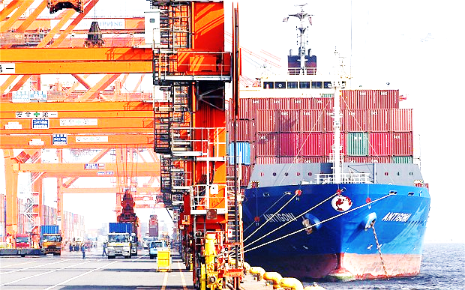
Trade in Goods Liberalisation
    ASEAN-6
    99.65% tariff lines eliminated
    CLMV
    Almost 98% tariff lines reduced to 0-5%
32

Slide 33
Facilitating Movement of Professionals
ASEAN Qualification Reference Framework (AQRF)
Mutual Recognition Arrangements (MRAs) in 8 fields:
Engineering
Architecture
Accountancy
Surveying
Nursing
Medical practitioners
Dental practitioners
Tourism Professionals

Slide 34
Competitive Economic Region
AEC Pillar #2

Slide 35

Competitive Economic Region - Milestones
Competition policy and law
Consumer protection laws
International IP protocols
ASEAN Highway Network
ASEAN Single Shipping Market
ASEAN Power Grid
Trans-ASEAN Gas Pipeline
Principles for PPP Frameworks
ASEAN Open Skies Policy
Telecommunication infrastructure
Notes:
35
Pillar 2: Competitive Economic Region
In creating a competitive economic region, the AEC seeks to foster a culture of fair competition, including institutions and laws that underpin the effort. This includes protection for consumers region-wide and strong guarantees for intellectual property rights.
Competition policy and law will play an increasingly important role as strong economies are founded upon healthy and effective competition. By creating a level playing field for businesses operating in the region, competition policy and law encourages greater innovation, productivity and efficiency, bringing about benefits for businesses and consumers alike.
ASEAN Member States have been intensifying their efforts to introduce competition policy and law by 2015. Various outreach activities have also been carried out to educate the general public on the importance of competition policy and how it could possibly affect them.
MILESTONES:
Introduce competition policy and law, outreach activities.
Capacity building to put in place, implement consumer protection laws.
Endeavour to accede to international IP protocols.
The ASEAN Highway Network physically connects key roadways. Implementation framework of ASEAN Single Shipping Market.
Six out of 16 cross-border connections of ASEAN Power Grid in operation. The Trans-ASEAN Gas Pipeline connects ASEAN’s infrastructure. Lao, MYS, SGP and THA explore cross-border power trade.
Principles for PPP Frameworks, ASEAN Business & Inv Summit, Japan Public-Private Summit, ASEAN-US Business Summit, AEC symposium.
Agreements, protocols of ASEAN Open Skies Policy implemented
Continuous enhancement of telecommunication infrastructure.
35

Slide 36

ASEAN Open Skies Policy
Capacity of ASEAN airlines almost tripled from 94 million seats in 2003 to 268 million seats in 2013
Capacity to absorb international arrivals also tripled, from 33 million to 99 million in the same period
Notes:
Leads to remarkable development of ASEAN aviation

Slide 37
Competition Policy
Strengthening Regulatory Environment
Regional Competition Advocacy
Cross-Cutting Regional Initiatives
Institutional-Building and Enforcement of CPL
Notes:
7 AMS have Competition Law (CPL) and Competition Authorities in place
Strengthening Regulatory Environment in ASEAN
Kick-off Workshop on Sector Studies for the AEGC
Advice on Drafting Competition Laws and Implementing Regulations
Institutional-Building and Enforcement of CPL
Guidelines on Developing Core Competencies
Competition Regulatory Experts Secondment
Building Competition Law Enforcement Capability
Strategy and Tools for Regional Competition Advocacy
AEGC Website
Phase II Regional Competition Advocacy
In-Country Workshop in CLM to Raise Awareness and/ Study on Economic Benefits and Possible Challenges of CPL
Workshop on Promoting Business Compliance for CPL in ASEAN
Cross-Cutting Regional Initiatives
ASEAN Competition Conference
Development of a Regional Cooperation Framework on Enforcement, Information-Sharing, and Technical Assistance Relative to CPL

Slide 38
Equitable Economic Region
AEC Pillar #3

Slide 39

Equitable Economic Development - Milestones
ASEAN Business Incubator Network
ASEAN SME Guidebook
Initiative for ASEAN Integration (IAI)
ASEAN Framework for Equitable Economic Development
ASEAN Equitable Development Monitor Report
Notes:
39
The ASEAN Business Incubator Network (30) promotes business matching and development.
The ASEAN SME Guidebook has been developed. But SME is cross cutting. Mainstreaming of SME considerations in post-2015 WP urged.
Implementation of the Initiative for ASEAN Integration (IAI) Work Plan 2 on-going. Like SME, efforts on Narrowing the Development Gap shared responsibilities across sectoral bodies. IAI post-2015 agenda discussed.
The ASEAN Framework for Equitable Economic Development was introduced in 2011, its operationalisation supported by the ASEAN Equitable Development Monitor Report, serving as a common basis.
39

Slide 40
Integration Into Global Economy
AEC Pillar #4

Slide 41
ASEAN Free Trade Agreements
 | Entry Into Force | Size of Market | Size of Economy ($) | Total Trade ($)
ACFTA (China) | 2005 | 1.98 B | 11.3 T | 351 B
AKFTA (Korea) | 2007 | 0.67 B | 3.59 T | 135 B
AJCEP (Japan) | 2008 | 0.75 B | 7.41 T | 241 B
AANZFTA (Aus-Nzl) | 2010 | 0.65 B | 4.07 T | 78 B
AIFTA (India) | 2010 | 1.87 B | 4.16 T | 68 B
AHKFTA (Hong Kong) | Jul 2014* | 0.63 B | 2.67 T | 97 B
RCEP | May 2013* | 3.4 B | 20.9 T | 872 B
* First round of negotiations
Notes:
41
Pillar 4: Integration into the Global Economy
One of the important success stories of the AEC is ASEAN’s integration into the global economy.
Through a number of “ASEAN+1” free trade agreements with the People’s Republic of China, Japan, the Republic of Korea, Australia, New Zealand and India, ASEAN is well-positioned at the centre of global supply chains, and has developed strong trade links with the major regional economies, which has allowed for the creation of significant business opportunities.
ASEAN is also negotiating the Regional Comprehensive Economic Partnership (RCEP), an FTA involving ASEAN and its six FTA partners. The ASEAN-led agreement, expected to be concluded by the end of 2015, will allow ASEAN to achieve a modern, comprehensive, high-quality and mutually beneficial economic partnership agreement with its FTA partners. With a combined GDP of about US$21.2 trillion, which is about 30% of global GDP, the RCEP also has the potential to transform the region into an integrated market of about 3.4 billion people (or 48% of the world’s population). When concluded, RCEP is expected to deliver tangible benefits to businesses through potential improvements in market access, trade facilitation, regulatory reform and more liberal rules of origin.
“ASEAN+1” FTAs with China, Japan, the Republic of Korea, Australia, New Zealand and India position ASEAN at the centre of GSCs.
Negotiating the Regional Comprehensive Economic Partnership (RCEP), a regional agreement involving ASEAN and its six FTA partners. RCEP will represent a combined GDP of ~US$21.2 trillion, about 30% of global GDP, and a market of 3.4 billion people (48% of the world’s population). Target conclusion end-2015 with ASEAN as a driver of mega regionals.
Negotiations to upgrade ACFTA started in September 2014. Oldest ASEAN FTAs, coverage and provisions outdated.
AHKFTA negotiations started in July 2014 – expected conclusion in 2016
AJCEP near conclusion of trade in services and investment chapters.
AIFTA agreements on trade in services and investment signed.
41

Slide 42
Regional Comprehensive Economic Partnership (RCEP)
Integration of the ASEAN economy into the global economy continues by enhancing ASEAN+1 FTAs, and establishment of RCEP and ASEAN-HK FTA
Regional Comprehensive Economic Partnership
AFTA
AKFTA
AJCEP
ACFTA
AIFTA
AANZFTA
AHKFTA
ASEAN’s other external economic partners
Notes:
Negotiations for the Regional Comprehensive Economic Partnership (RCEP) continue to progress after five rounds.
The fifth round of negotiations was held in June 2014.
Ministers reaffirmed the aim to conclude RCEP negotiations by end-2015.

Slide 43

Initiative for ASEAN Integration
Narrow the development gap
CLMV assisted, ensuring benefits of ASEAN integration are equitably shared
Positive-bias approach: Growing the ASEAN cake and increasing the share going to the CLMV countries
Notes:
Integration helps narrow the development gap across the three ASEAN pillars
Cambodia, Lao PDR, Myanmar, Viet Nam (CLMV) assisted in implementing their commitments, ensuring benefits of ASEAN integration are equitably shared
Positive-bias approach: Growing the ASEAN cake and increasing the share going to the CLMV countries
Publication on “Narrowing the Development Gap in ASEAN: Drivers and Policy Options (2013)
Mid-term Review of the IAI Work Plan II (2009-2015) → Completed

Slide 44
ASEAN GDP
Source: ASEAN Integration Monitoring Office (AIMO)

Slide 45
ASEAN 2015 & Post-2015

Slide 46
Priorities Towards AEC 2015
Fast track implementation of prioritised AEC deliverables
Improve communication and outreach to stakeholders
Finalise AEC’s post-2015 agenda for deeper REI
46
Notes:
Fast track implementation of prioritised AEC deliverables:
Beyond tariffs: Improved trade facilitation – customs, self certification, tariffs, NTBs
Beyond commitments: making rules & regulations work
The missing links: transport networks and the quality of transport infrastructure
Improve communication and outreach to stakeholders:
Access to Information on benefits of AEC is suboptimal
Appropriate key messages to national & regional audiences needed
Finalise AEC’s post-2015 agenda for deeper REI:
To ensure expeditious completion of outstanding AEC 2015 measures
To incorporate lessons and experiences from AEC 2015 and be forward looking

Slide 47
AEC 2025
Integrated and highly cohesive economy
Competitive, innovative and dynamic ASEAN
Enhanced sectoral integration and cooperation
Resilient, inclusive, people-oriented and people-centered ASEAN
Global ASEAN

Slide 48
Post-2015 Vision for AEC
An ASEAN Economic Community for 2016-2025 (AEC 2025) that includes an integrated and highly cohesive economy, a competitive, innovative and dynamic ASEAN, a resilient, inclusive and people-oriented, people-centred ASEAN, enhanced sectoral integration and cooperation, and a global ASEAN.

Slide 49
ASEAN Socio-Cultural Community
Draft Slide Templates
July 2015
Notes:
Core pillar colours: shades of yellow/gold

Slide 50

ASCC Community Building Mandate
People-oriented & socially-responsible to achieve enduring solidarity & unity
Common identity to build caring, sharing and inclusive society
Notes:
Realising an ASEAN Community that is people-oriented and socially-responsible to achieve enduring solidarity and unity among the peoples and Member States of ASEAN
Forming a common identity and build a caring and sharing society which is inclusive and where the well-being, livelihood, and welfare of the peoples are enhanced

Slide 51
ASCC Blueprint
Primary Goal:
  To contribute to realising a people-centred and socially-responsible ASEAN Community by forging a common identity and building a caring and sharing society
Human Development
Environmental Sustainability
Building ASEAN Identity
Social Welfare & Protection
Narrowing the Development Gap
Social Justice & Rights
Notes:
Characteristics of the ASCC Blueprint:
Human Development: 7 elements, 61 actions
Social Welfare and Protection: 7 elements, 94 actions
Social Justice and Rights: 3 elements, 28 actions
Ensuring Environment Sustainability: 11 elements, 98 actions
Building ASEAN Identity: 4 elements, 50 actions
Narrowing the Development Gap: 8 actions

Slide 52

Human Development
Advancing and prioritising education
Human resource development
Promotion of decent work
Promoting ICT
Access to applied Science & Technology
Entrepreneurship skills for women, youth, elderly, and persons with disabilities
Building civil service capability
Notes:
ASEAN will enhance the well-being and livelihood of the peoples of ASEAN by providing them with equitable access to human development opportunities by promoting and investing in education and life-long learning, human resource training and capacity building, encourage innovation and entrepreneurship, promote the use of English language, ICT and applied science and technology in socio-economic development activities.

Slide 53

Social Welfare and Protection
Poverty alleviation
Social safety net and protection from the negative impacts of integration and globalisation
Enhancing food security and safety
Access to healthcare and promotion of healthy lifestyles
Improving capability to control communicable diseases
Ensuring a drug-free ASEAN
Building disaster-resilient nations and safer communities
Notes:
ASEAN is committed to enhancing the well-being and the livelihood of the peoples of ASEAN through alleviating poverty, ensuring social welfare and protection, building a safe, secure and drug free environment, enhancing disaster resilience and addressing health development concerns.
Poverty alleviation
Social safety net and protection from the negative impacts of integration and globalisation
Enhancing food security and safety
Access to healthcare and promotion of healthy lifestyles
Improving capability to control communicable diseases
Ensuring a drug-free ASEAN
Building disaster-resilient nations and safer communities

Slide 54

Social Justice and Rights
Promotion and protection of the rights and welfare of women, children, the elderly and persons with disabilities
Protection and promotion of the rights of migrant workers
Promoting corporate social responsibility (CSR)
Notes:
ASEAN is committed to promoting social justice and mainstreaming people’s rights into its policies and all spheres of life, including the rights and welfare of disadvantaged, vulnerable and marginalised groups such as women, children, the elderly, persons with disabilities and migrant workers.
Promotion and protection of the rights and welfare of women, children, the elderly and persons with disabilities
Protection and promotion of the rights of migrant workers
Promoting corporate social responsibility (CSR)

Slide 55

Environmental Sustainability
Trans-boundary environmental pollution
Education and public participation
Environmentally Sound Technology (EST)
Policies and databases
Use of coastal & marine environment
Management of natural resources & biodiversity
Freshwater Resources
Climate Change
Sustainable Forest Management (SFM)
Notes:
Addressing global environmental issues
Managing and preventing trans-boundary environmental pollution
Promoting sustainable development through environmental education and public participation
Promoting Environmentally Sound Technology (EST)
Promoting sustainable development through environmental education and public participation
Harmonizing environmental policies and databases
Promoting the sustainable use of coastal & marine environment
Promoting Sustainable Management of Natural Resources & Biodiversity
Promoting the Sustainability of Freshwater Resources
Responding to Climate Change and addressing its impacts
Promoting Sustainable Forest Management (SFM)

Slide 56

Building ASEAN Identity
Promotion of ASEAN awareness and a sense of community
Preservation and promotion of ASEAN cultural heritage
Promotion of Cultural Creativity and Industry
Engagement with the community
Notes:
Promotion of ASEAN awareness and a sense of community
Preservation and promotion of ASEAN cultural heritage
Promotion of Cultural Creativity and Industry
Engagement with the community

Slide 57

Narrowing the Development Gap
Issues in developing and implementing projects under IAI & other sub-regional frameworks
ASEAN-6 to continue assisting the CLMV
Assessment studies on social impact of regional integration
Notes:
Mainstream social development issues in developing and implementing projects under the Initiative for ASEAN Integration (IAI) & other sub-regional frameworks
ASEAN-6 to continue assisting the CLMV
Undertake assessment studies on the social impact of regional integration

Slide 58
ASCC Community-Building Milestones
Heightened commitments:
  Declaration on Non-communicable Diseases in ASEAN
  Declaration on Elimination of Violence Against Women and Elimination of Violence Against Children in ASEAN
  Development of ASEAN instruments for the protection and promotion of the rights of migrant workers
Quick, tangible action
  Humanitarian assistance through the ASEAN Coordinating Centre for Humanitarian Assistance (AHA Centre)

Slide 59
ASCC Post-2015 Vision
An ASEAN Socio-Cultural Community that is inclusive, sustainable, resilient, dynamic and engages and benefits the people.

Slide 60
ASEAN Template Usage
This template is designed to provide a selection of standardised key slides that can be used by AMS in preparing presentations about ASEAN.
Slides can be deleted or added to with additional local information and examples to create presentations. It is not expected that all slides will be used in a presentation.
Please use the format of this presentation to create additional slides.
Please email copies of any presentations created to public@asean.org as this will enable ASEC to capture local information for sharing at ASEC and with AMS.
Updated presentations and additional information can be found at http://www.asean.org/resources/asean-resources-tool-kit
Updated: July 2015

